Slide 1
Open Access Software to Advance Active Learning, Automate Grading, and Reduce Cheating in Excel
2024 AAA CTLA – Annual Meeting
Mary Sasmaz, Raymond Frost, Ellen Gordon, Lauren Kenyo, Vic Matta
Please do this now:
Download and install the software from ScoreboardExcel.com

Slide 2
Software Overview
Motivation / Big Picture
Demo Scoreboard Excel Software
Student Experience
Honesty Controls
Educator Perspective
Paper in 2nd revision with Issues in Accounting Education

Slide 3
Motivation
Scoreboard was designed to promote active learning for students to become efficient Excel users. We wanted to do this without creating a grading burden for faculty.
Considerations
Interactive Student Experience
Honesty Controls
Faculty Burden
Authoring in Real Time

Slide 4
Scoreboard Student Experience
Each of the following slides has an animated loop showing the student making an entry along with Scoreboard’s feedback

Slide 5
Scoreboard awards points & positive feedback (for the correct solution)
Notes:
When a student attempts a formula, the cells

Slide 6
Scoreboard coaches to use formulas (if the answer key contains a formula)

Slide 7
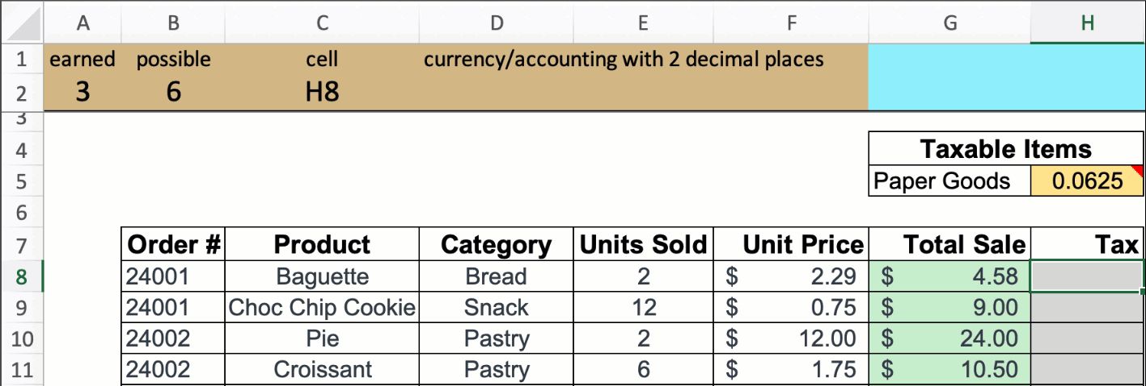
Scoreboard prompts to correct errors (in this case there is a missing IF statement for nontaxable items)

Slide 8
Scoreboard prompts for cell references (if the answer key contains cell references)

Slide 9
Scoreboard prompts for absolute references (if the answer key contains absolute references)

Slide 10
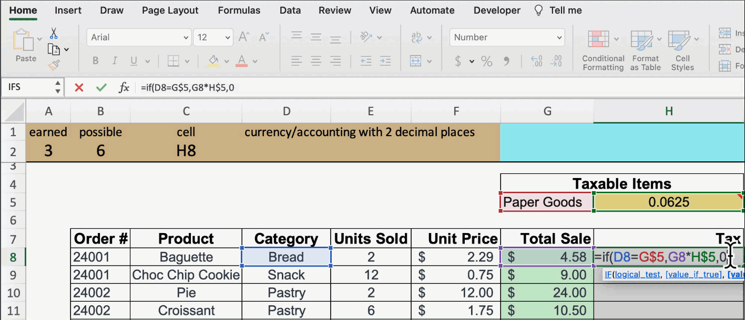
Scoreboard prompts to apply correct formatting (to match the formatting on the answer key)

Slide 11
Scoreboard Honesty Controls
Each of the following slides has an animated loop showing honesty controls
The general idea behind Scoreboard’s honesty controls is that it is not possible to cheat off of another student if students don’t have the same assignments.

Slide 12
Scoreboard assigns unique values and formulas to each student's workbook (if the professor requests it)

Slide 13
Scoreboard deters copying other students’ work (the pink screen of doom!)

Slide 14
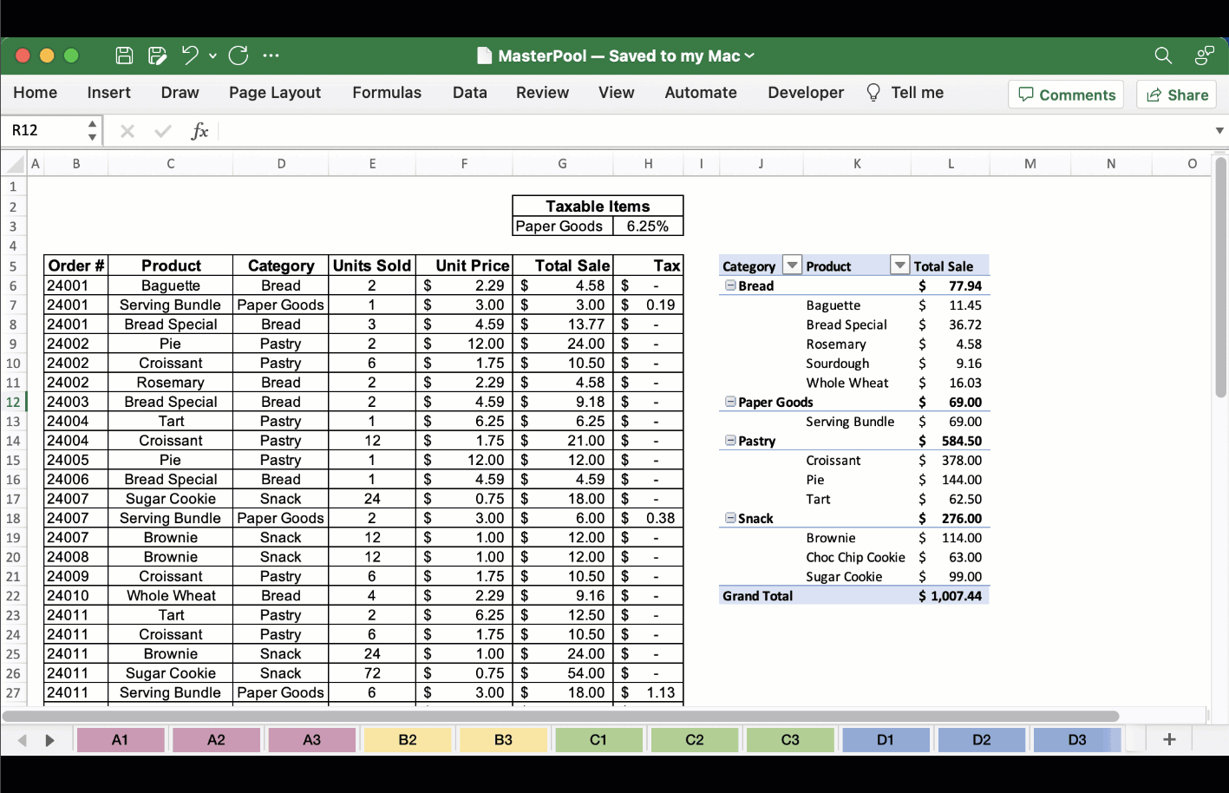
Scoreboard creates unique workbooks from a master pool of worksheets

Slide 15
Workshop Outline
Slide show
Demo the start file
Work with the start file
Demo creation of a start file
Install Scoreboard on your own system
Create your own start file

Slide 16
Workshop Outline
Slide show
Demo the start file
Work with the start file
www.ScoreboardExcel.com/CTLA
Demo creation of a start file
Install Scoreboard on your own system
Create your own start file

Slide 17
Scoreboard Authoring
Freedom to use self-created assignments
Solution files can be shared among faculty
Simple Interface
Instant creation of multiple versions of assignments in minutes

Slide 18
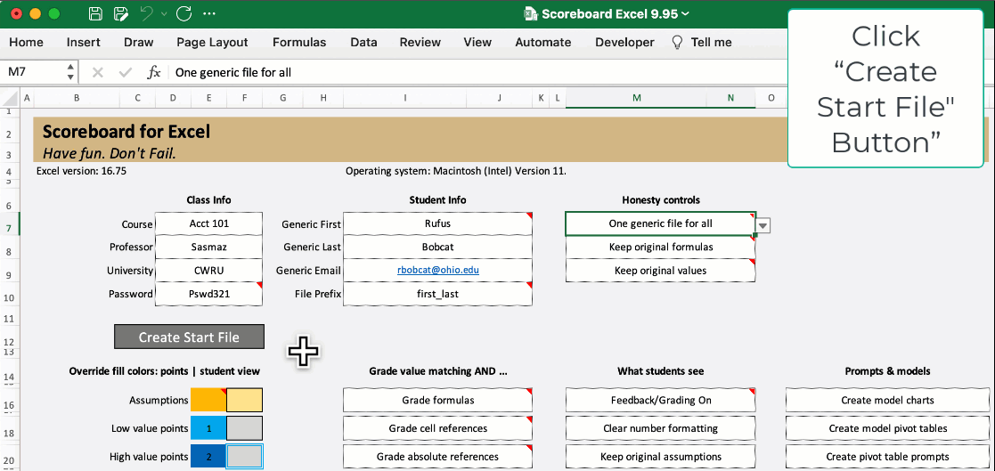
Authoring: Instant File Creation

Slide 19
Free Download! Questions?
ScoreboardExcel.com
Mary Sasmaz, mbs26@case.edu
Raymond Frost, FrostR@ohio.edu, text: 740.591.3253
Ellen Gordon, GordonE@ohio.edu
Lauren Kenyo, Kenyo@ohio.edu
Vic Matta, Matta@ohio.edu

Slide 20
End of Show

Slide 21
Analytics Course Topics
Excel Basics
Foundations of Excel
Managing Data
Qualitative Descriptive Analytics
Quantitative Descriptive Analytics
Multivariate Descriptive Analytics
Probability of a Single Value
One Sample Hypothesis Testing
Introduction to Predictive Analytics
Data Visualization with Tableau

Slide 22
Scoreboard Student Experience: Auto-Coaching
Provides instant automated coaching to the student in real-time.
Just enough information to coach the student to fix their own mistakes.
Trains students to become EFFICIENT users of Excel
Scoreboard tracks student performance
Stop-light coloring is easy to understand

Slide 23
Survey Items
I enjoyed doing this assignment very much.
I thought this was a boring assignment. (R)
This assignment did not hold my attention at all. (R)
I would describe this assignment as very interesting.
While I was doing this assignment, I was thinking about how much I enjoyed it.
I think I am pretty good at this assignment.
After working at this assignment for a while, I felt very competent.
I am satisfied with my performance with this assignment.
I was skilled at this assignment.
This was an assignment that I couldn’t do very well. (R)
I felt very nervous while doing this assignment. (R)
I did not feel tense at all while doing this assignment.
I was very anxious in doing this assignment. (R)
I was completely relaxed while working on this assignment.
I did not feel pressured at all while doing this assignment.
Additional Questions
What percentage of problems did you fix after the hints/feedback indicated your work was incorrect?
Based on your best estimate, how much time did you spend completing the assignment?

Slide 24
End of the Semester Scoreboard Survey
Itemª | Strongly Disagree | Disagree | Slightly Disagree | Neither Agree nor Disagree | Slightly Agree | Agree | Strongly Agree | Mean^{b} (SD) | T-statistic and P-value
I feel I know the content better after using the new grading system. | 0.5% | 0.3% | 0.8% | 3.3% | 14.4% | 45.1% | 35.5% | 6.08 (0.93)*** | t (395) = 44.80 p < .001
I feel more confident about doing my work | 0.5% | 0.3% | 0.0% | 1.3% | 15.1% | 37.0% | 45.6% | 6.25 (0.88)*** | t (395) = 50.99 p < .001
The new grading system helps me learn better. | 0.5% | 0.3% | 1.3% | 4.3% | 13.1% | 38.0% | 42.3% | 6.13 (1.00)*** | t (395) = 42.63 p < .001
I am more stressed with the new system. | 28.7% | 39.8% | 12.3% | 9.3% | 4.5% | 3.5% | 1.5% | 2.62 (1.42)*** | t (395) = 22.83 p < .001
I believe I can succeed with the new system. | 0.5% | 0.0% | 0.0% | 4.3% | 13.6% | 45.1% | 36.3% | 6.12 (0.89)*** | t (395) = 47.49 p < .001
I am proud of the outcome of my assignments. | 0.5% | 0.0% | 1.8% | 3.5% | 15.6% | 40.6% | 37.8% | 6.07 (0.98)*** | t (395) = 42.13 p < .001
ªAll items were measured on a 7-point scale with 1 being Strongly Disagree and 7 being Strongly Agree.
^{b}All means were statistically compared to the midpoint of 4 (Neither Agree nor Disagree) using a One-Sample T-test.
***p < .001

Slide 25
Scoreboard currently used with ….
Excel Basics
Foundations of Excel
Managing Data
Qualitative Descriptive Analytics
Quantitative Descriptive Analytics
Multivariate Descriptive Analytics
Probability of a Single Value
One Sample Hypothesis Testing
Introduction to Predictive Analytics
Financial Statement Analysis
Building Financial Statements

Slide 26
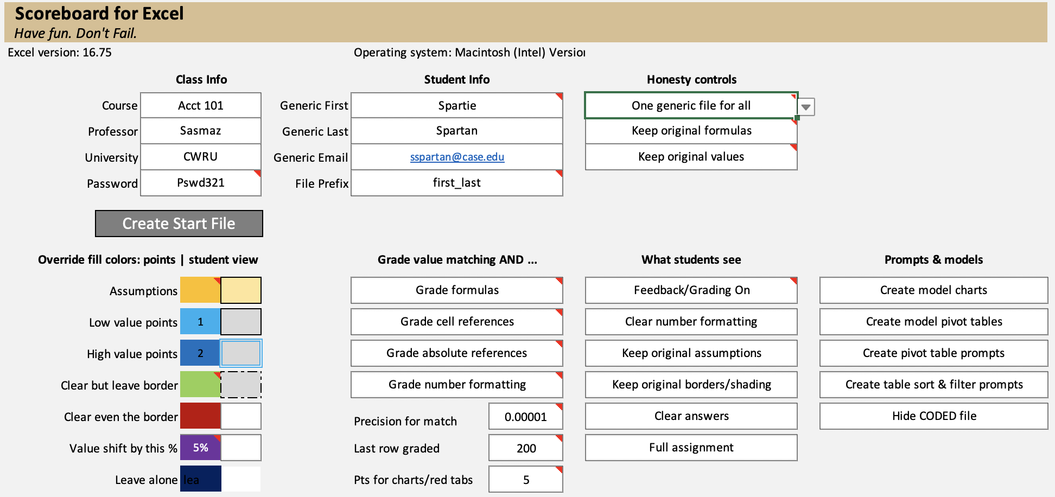

Slide 27
Scoreboard: A Classroom Experiment
397 undergraduate students at 2 midwestern universities
3 sections of Introduction to Accounting Course
5 sections of Introduction to Business Analytics Course (one online section)
Most student participants had little/no previous experience with Excel
(46.3% no experience, 41.3% beginner level)
2 assignments
HW 1: All students did same assignment with traditional hints built in
Topics: Basic Excel Skills: Average, Sum, Count
HW 2: Approximately 50% of students used Scoreboard, the other 50% had traditional Hints
Topics: Basic Excel skills: formula writing, absolute references, and IF functions
Observed: Intrinsic motivation, % of incorrect work fix, time spent completing the assignment, assignment grade
Notes:
-We conducted a classroom study to determine the effectiveness of Scoreboard. A total of 397 students consented to share their data. These participants were recruited from several Intro to Accounting and Intro Business Analytics courses – both of which taught various Excel skills.
-Approximately 88% of the participants had no to limited experience with Excel.
-We conducted a quasi -experiment that spanned two assignments. All students across classes and schools completed the same assignments.
In HW 1, students were only given traditional hints – that is, they were provided with the correct, final answer for a subset of the problems. These hints were stored as a note in Excel.
For HW 2, we assigned half of the classes we provided with an assignment with Scoreboard, the other half was given the same assignment with traditional hints only. Thus, we had two conditions: a Scoreboard group and a hints group.
After each assignment, we asked students to complete a short survey: this survey measured intrinsic motivation, asked students to estimate how much incorrect work they were able to fix, and how much time they spent on the assignment. We also recorded their grades.
It is important to note that these two groups did not have any differences on HW 1 – that is, they did not differ in their intrinsic motivation, % of work fixed, time spent, and grades. This helps rule out any pre-existing differences.

Slide 28
Scoreboard vs. Hints in Comments - Mean(SD)
 | Scoreboard | Traditional Hints | T-statistic | P-value
Overall Intrinsic Motivation Scale | 4.59 (1.09) | 4.35 (1.06) | t (391) = 2.08 | p = .038*
% of Incorrect Work Fixed | 45.39% (32.82%) | 37.42% (31.42%) | t (377) = 2.35 | p = .019*
Time Spent on Assignments (in minutes) | 112.86 (72.39) | 125.09 (86.39) | t (390) = 1.52 | p = .130
Grade | 96.53% (12.32%) | 80.58% (15.16%) | t (395) = 11.51 | p < .001***
Conclusions:
Students who used Scoreboard indicated higher scores on the internal motivation questionnaire.
Students using Scoreboard self-reported a higher likelihood of student’s fixing mistakes.
Scoreboard users received higher grades.
Notes:
However, significant differences emerged on the second assignment. Specifically, students who used Scoreboard had significantly higher intrinsic motivation and reported fixing a higher amount of incorrect work and received significantly higher grades. They did not differ on how much they estimated working on the assignment.

Slide 29
End of the Semester Scoreboard Survey
Itemª | Agree (6) | Strongly Agree (7) | Mean^{b} (SD) | T-statistic and P-value
I feel I know the content better after using the new grading system. | 45.1% | 35.5% | 6.08 (0.93)*** | t (395) = 44.80 p < .001
I feel more confident about doing my work | 37.0% | 45.6% | 6.25 (0.88)*** | t (395) = 50.99 p < .001
The new grading system helps me learn better. | 38.0% | 42.3% | 6.13 (1.00)*** | t (395) = 42.63 p < .001
I am more stressed with the new system. | 3.5% | 1.5% | 2.62 (1.42)*** | t (395) = 22.83 p < .001
I believe I can succeed with the new system. | 45.1% | 36.3% | 6.12 (0.89)*** | t (395) = 47.49 p < .001
I am proud of the outcome of my assignments. | 40.6% | 37.8% | 6.07 (0.98)*** | t (395) = 42.13 p < .001
ªAll items were measured on a 7-point scale with 1 being Strongly Disagree and 7 being Strongly Agree.
^{b}All means were statistically compared to the midpoint of 4 (Neither Agree nor Disagree) using a One-Sample T-test.
***p < .001
Notes:
We also administered an end of the semester survey which assessed student’s experience and impression of Scoreboard.
Overall, students gave very high ratings to Scoreboard. The majority (over 80%) either agreed or strongly agreed that they knew the content better, felt more confident and proud of their work. They disagreed that the system caused stress. We compared the average rating for each item to the midpoint – which was neither agree nor disagree. All analyses were statistically significant. Overall, students self-reported experience with Scoreboard was very positive.

Slide 30
Contribution and Future Research
Facilitate Excel earlier in the curriculum and more often
Experiment suggests Scoreboard is an effective learning aid for Excel skills – including pivot tables, charts, sorting and filtering
Can be used for widespread sharing of Excel assignments among faculty by sharing of a start file or a solution file
Future research:
Underlying motivations or behavioral aspects that make interactive spreadsheets effective
Tracking long-term efficacy of interactive spreadsheeting early in a student’s career

