Slide 1

Real-Time Data Visualization in Statistics Education
Enhancing Conceptual Understanding Through Interactive Visual Feedback using Scoreboard for Excel
Raymond Frost, Ohio Univ
Timothy Haase, Ramapo College
Janna Chimeli, Ohio Univ
Ellen Gordon, Ohio Univ
Lauren Kenyo, Ohio Univ
Vic Matta, Ohio Univ
Adam Moyer, Ohio Univ

Slide 2
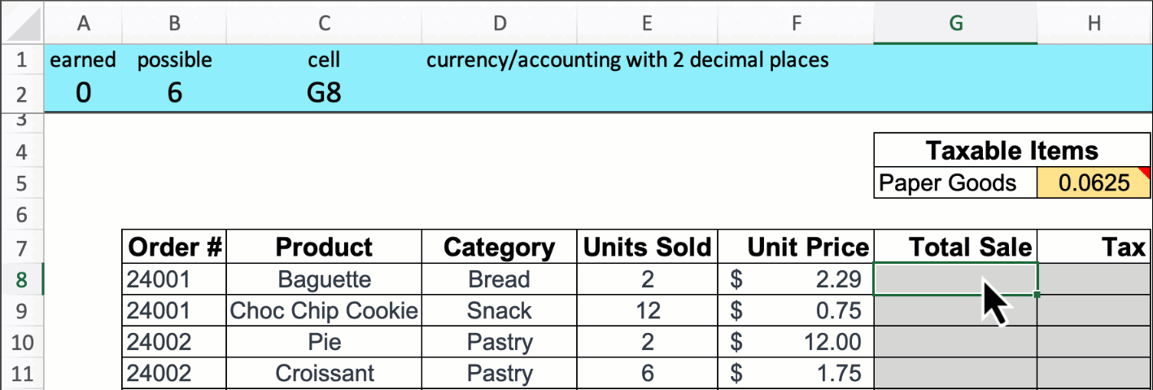
Scoreboard in Action
Evidence of classroom success in stats:
  Increases learning for all students
  Levels the playing field for students lacking prior stats or Excel knowledge
    Haase, Moyer, and Frost (2025) Journal of Education for Business
    Haase, Moyer, Frost, and Gonpu (2025) Journal of Research in Business Education
Curiosity:
  Are we improving understanding?
    Or are they auto-piloting formula entry?
Including real-time visualizations may bridge that gap

Slide 3
Visualization tools
Motivation: If I had $1 for every time I tell students to ‘draw the curve’ ..
I would not need to leave this island.
Real-time distributional graphs are constructed as students correctly calculate statistics
  Mean, standard deviation, standard error, critical values, etc.
Graphs illustrate positioning in distributions
  Test statistic, critical values, alpha, p-values, etc.
We suspect the visualization would improve learning due to the extra exposure and intuition
Are there benefits to these aids?
Access the website: www.scoreboardexcel.com

Slide 4
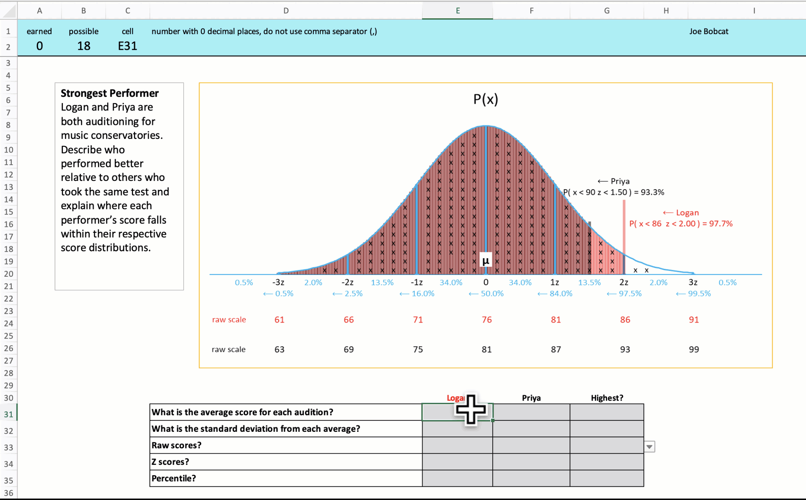
Pull Answers from Image

Slide 5
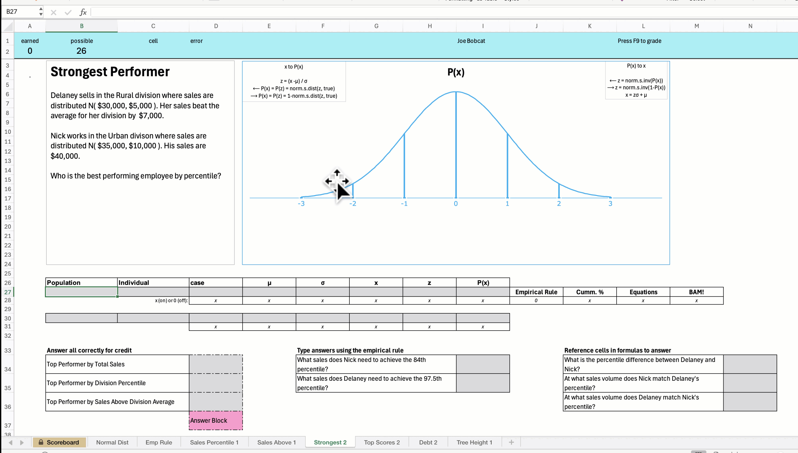
Auto Build Image from Answers

Slide 6


Method
Ohio University
Introductory Business Analytics (online & in-person)
  ~70-100 students per class
OU’s Visualization Journey:
  Spring 2024: No Visualizations
  Spring 2025: Draft Visualization Template
  Fall 2025: Finalized Visualization Template
Dependent Measures (FALL 2025 only):
  Homework & Exam Grades
  HW survey – included competency quiz and self-report questions (e.g., the dynamic chart helped me learn)
    All classes completed a survey at the end of the HW assignment.
    Competency quiz and self-report questions (examples
Research was conducted for one module – One Sample Z test
Ramapo College
Increased usage of Scoreboard beginning Fall 2023 Semester
  Assignments (Fall 2023)
  Assignments, Exams, In-class exercises (Spring 2024)
  Assignments, Exams, In-class exercises (Fall 2024)
    In-class exercises included Visual Aids as a ‘dashboard view’
  Assignments, Threshold Exams, In-class exercises (Fall 2025)
    In-class exercises included real-time adjusting distributional graphs
35 students per class
Same Instructor and course design
Survey completed at semester end
Compare Visualization classes to previous

Slide 7
Findings
Ohio University
Increased difficulty of the exam
  Increase in the size of the exam
  Increase in the number of conceptual questions
  Only a slight decrease in exam grades
Survey Questions
  The majority of students reported positive experiences with the visualizations
Ramapo College
Exam Scores: Visualization vs None
  Significant increase in exam scores within the Fall 2025 semester (Exams 2 & 3)
Survey Data: control for other factors
  GPA: Student Aptitude
  Prereq: Elementary Stats vs Other
Significant Increase remains for Exam #2
  Normal Distribution, Sampling Distribution, Confidence Intervals

Slide 8
Comparison: Visualization Tools
Exam: Discrete, Normal, Sampling Distributions
Score group | Spring/Fall 2024 | Fall 2025
90–100 | 19.0% | 53.3%
80–<90 | 23.0% | 16.7%
70–<80 | 17.0% | 13.3%
60–<70 | 20.0% | 3.3%
<60 | 21.0% | 13.3%
Statistic | Spring/Fall 2024 | Fall 2025
N | 100 | 30
Mean | 72.041 | 85.117***
Median | 72.9 | 91
Std Dev | 18.054 | 16.609
Skewness | -0.639 | -1.245
Min | 22.9 | 38.7
Max | 100 | 100

Slide 9
Comparison: Visualization Tools
Exam: Hypothesis Testing, Anova, Regression
Score group | Spring/Fall 2024 | Fall 2025
90–100 | 10.0% | 20.0%
80–<90 | 24.0% | 20.0%
70–<80 | 14.0% | 23.3%
60–<70 | 20.0% | 26.7%
<60 | 32.0% | 10.0%
Statistic | Spring/Fall 2024 | Fall 2025
N | 100 | 30
Mean | 68.534 | 75.03**
Median | 69.8 | 73
Std Dev | 18.262 | 16.065
Skewness | -0.591 | -0.331
Min | 15.7 | 36.5
Max | 99 | 100

Slide 10
Controlling for Student Knowledge
 | (1) | (2)
Variable | Exam #2 | Exam #3
Visualization | 13.098*** | 2.957
 | (2.693) | (3.009)
GPA | 21.432*** | 19.917***
 | (3.334) | (3.730)
Prerequisite | 6.865** | 1.851
 | (3.113) | (3.479)
Intercept | -5.679 | 1.401
 | (12.485) | (13.955)
Observations | 120 | 120
R-squared | 0.343 | 0.200
Adj. R-squared | 0.326 | 0.179
F-statistic | 20.22 | 9.66
RMSE | 14.66 | 16.39
Regress with Student Controls
  GPA
    Romer (1993)
    Proxy for underlying ability and motivation
    Pre-determined exogenous measure
  Prerequisite
    1: Elementary Prob & Stats
    0: Other

Slide 11
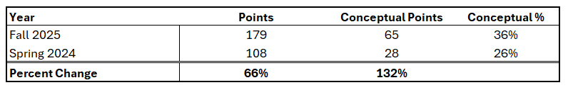
OU Finding #1: Visualizations allowed us to drastically increase the size and complexity of the exam, primarily through an increase in the number of conceptual questions, without taking a significant hit to exam grades.

Slide 12

We appreciate any comments, questions, or feedback
Sincerely,
The Ohio Gang and Redbeard

Slide 13
Comparison: Visualization Tools
Exam: Frequency Dist., Numerical Stats, Prob. Theory
Score group | Spring/Fall 2024 | Fall 2025
90–100 | 32.0% | 20.0%
80–<90 | 26.0% | 20.0%
70–<80 | 14.0% | 26.7%
60–<70 | 11.0% | 20.0%
<60 | 17.0% | 13.3%
Statistic | Spring/Fall 2024 | Fall 2025
N | 100 | 30
Mean | 77.637 | 74.71
Median | 85.2 | 74.3
Std Dev | 19.750 | 15.833
Skewness | -1.016 | -0.331
Min | 22.3 | 37.2
Max | 100 | 100

