Slide 1

Tab Pool Randomization:
Authentic Excel Assessment Through Automated Test Generation and Grading in Business Statistics Education
Lauren N. Kenyo
Timothy J. Haase
Janna Chimeli
Raymond D. Frost
Ellen R. Gordon
Vic Matta
Adam C. Moyer

Slide 2
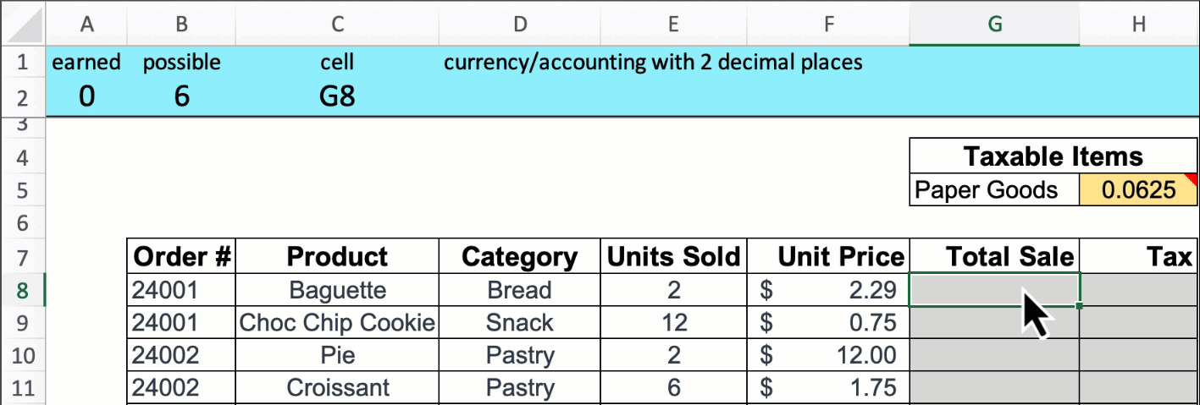
Scoreboard for Excel
Downloadable (AND FREE) EdTech software that works with Excel
  Office 365 or Excel 2021 versions – Mac or Windows
Make assignments, exams, in-class problems
Customized to your preferences
Provides feedback while users work through their files
Can create an entire class assignment/grade entire class in seconds
Can increase the difficulty and add additional honesty controls
Access the website:
www.scoreboardexcel.com

Slide 3
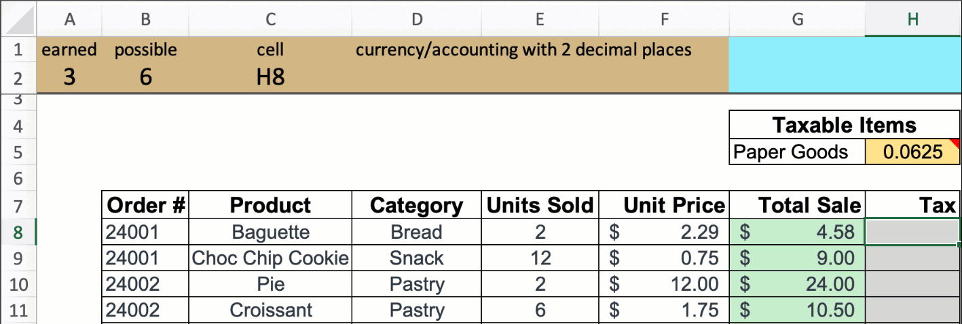
Scoreboard Features
Provides solution feedback in real time
Indicates correct and incorrect solutions with green and pink cell fill
Prompts users to fix:
  Incorrect answer values
  Manually typed values
  Missing cell references
  Missing absolute references
  Incorrect cell formatting

Slide 4
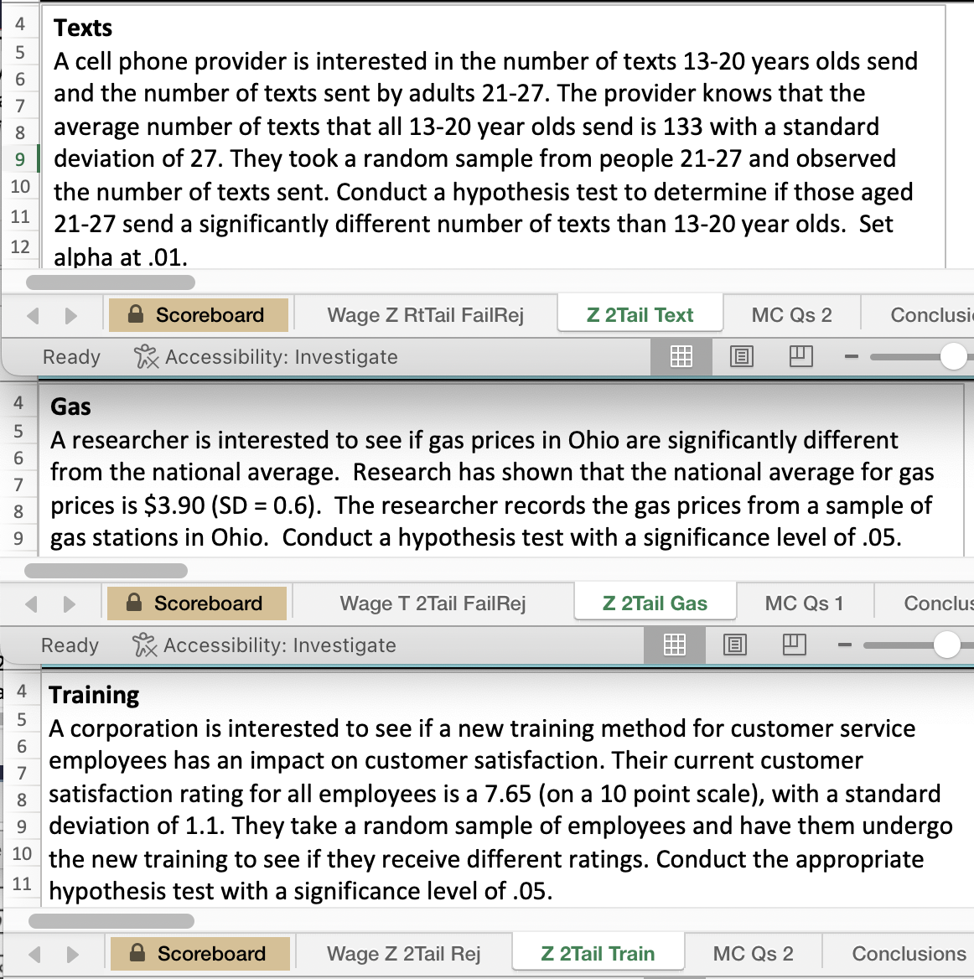
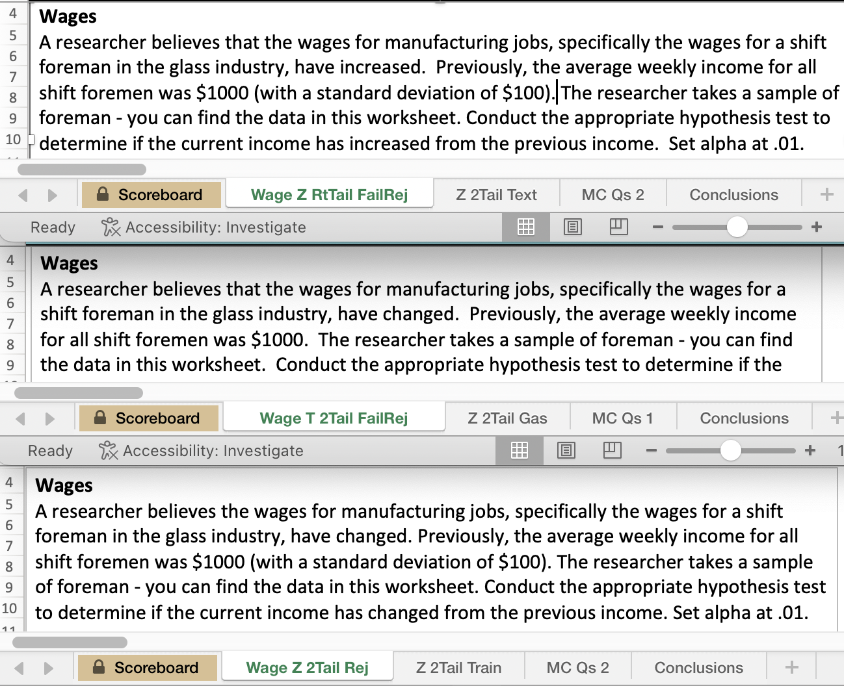
Tab Pools: Make Multiple Versions by Concept or Scenario
Same Concept: Z Test & 2 Tailed
Different Scenarios: Gas, Texts, Training
Same Scenario: Wages
Different Concepts: Z vs. T Test; 1 vs 2 Tailed

Slide 5
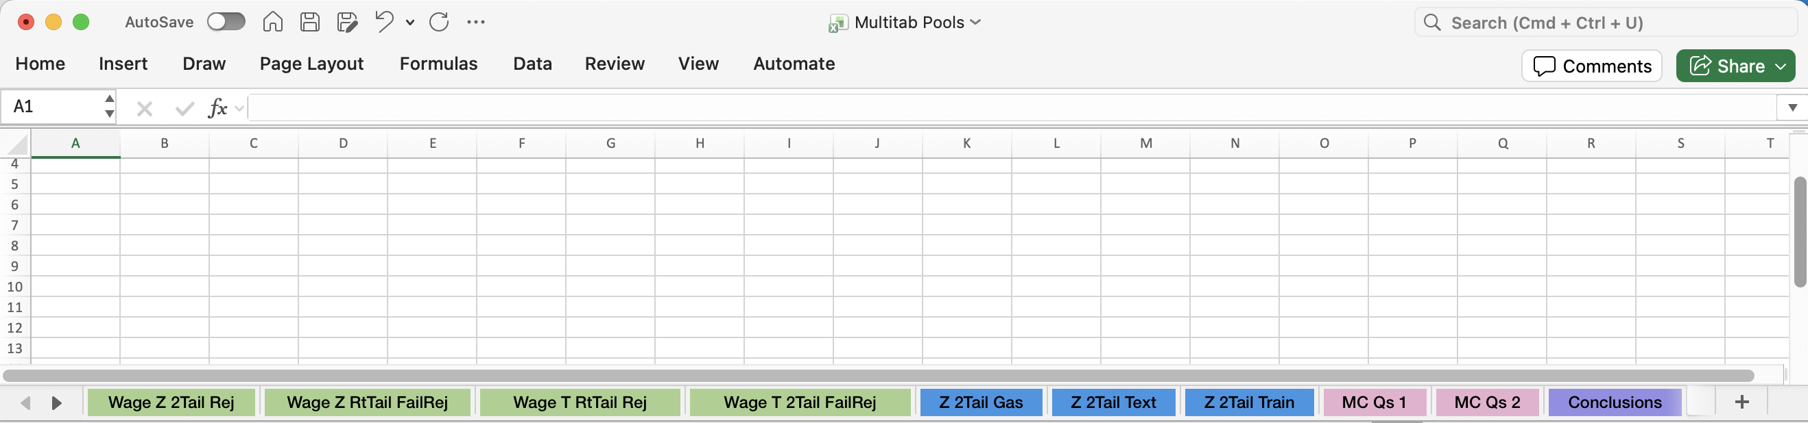




Tab Pool Randomization
All tabs from each pool (group) should be colored the exact same
Number of tabs in each pool may vary
Scoreboard will pull 1 tab from each color pool to create a unique file for each student
  If there’s only 1 tab in a color pool, every student will get that tab

Slide 6
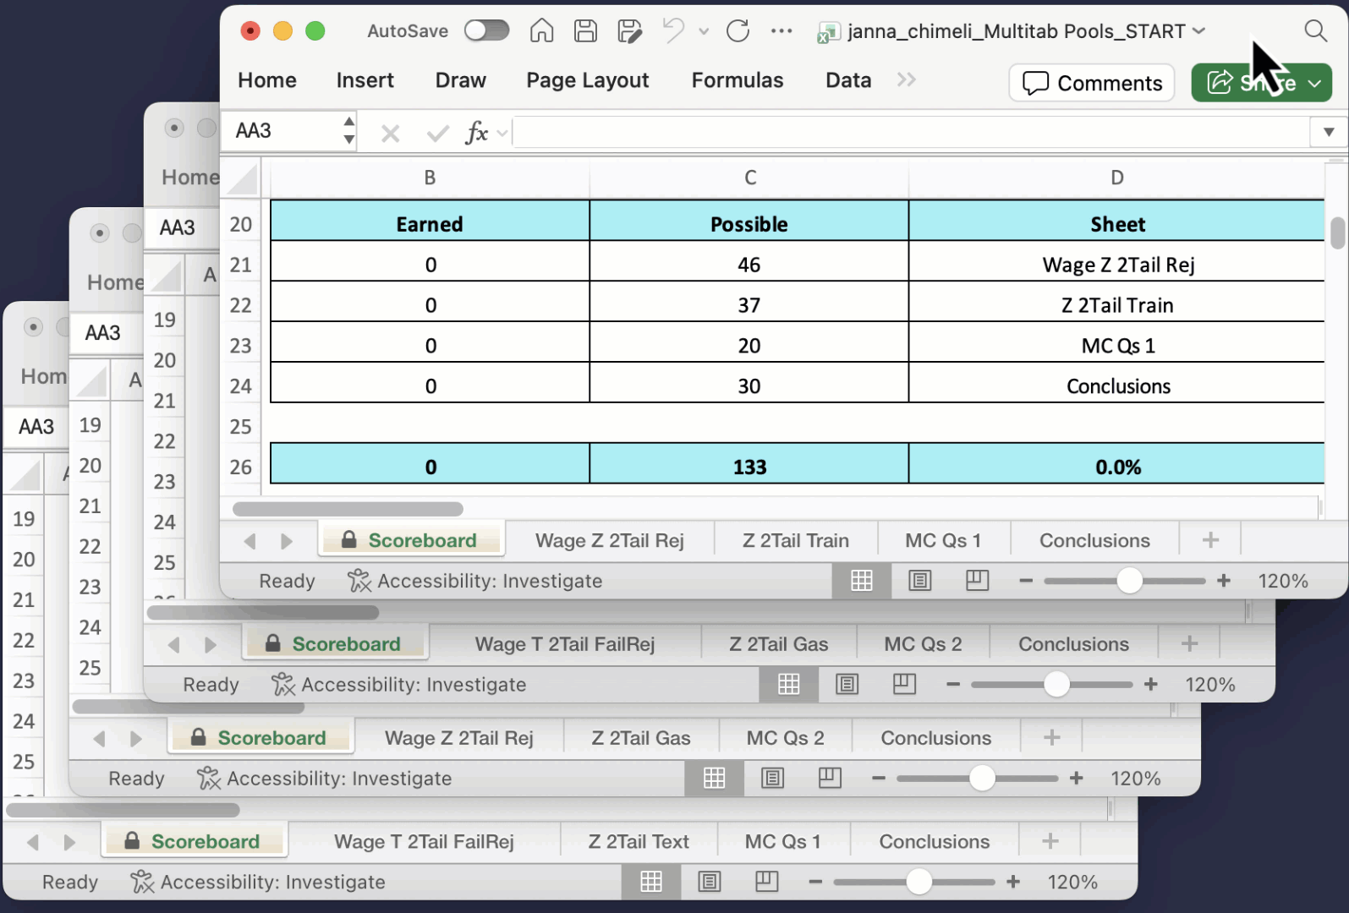
Basic Tab Pool Randomization
Randomly selects 1 tab from each
color pool
Uses original tab names
Maintains tab order

Slide 7
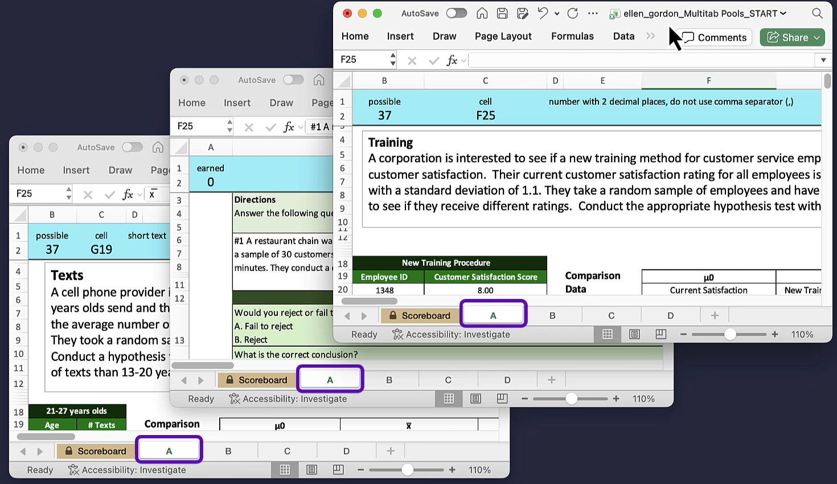
Tab Pool Randomization – Options
Randomize tab order
Rename tabs (A, B, C,…)

Slide 8
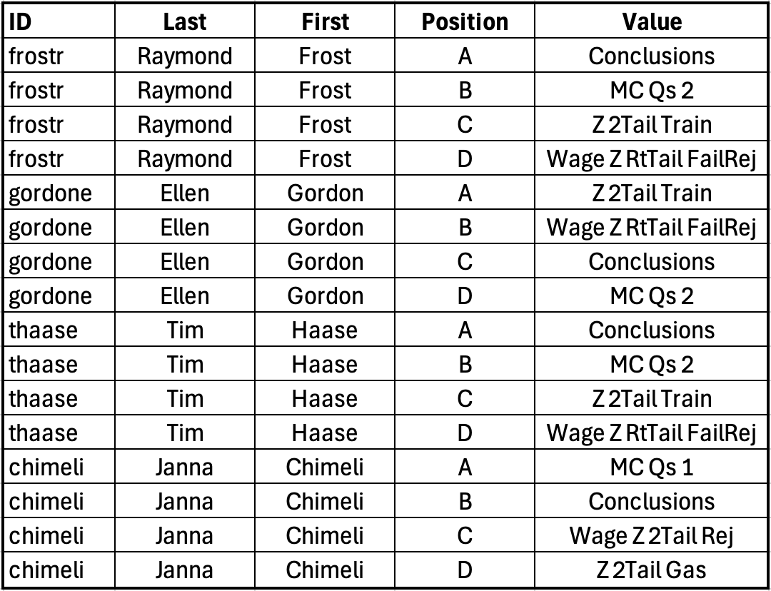
Tab Allocation – Who got what?
Table with individual student file’s
tabs and positions
Similarity depends on number of
versions in each color pool
  This example 1-4 versions in 4 tab pools:
  1 in 24 chance of getting an identical combination of tabs
  6 versions in 8 tab pools:
  1 in 1.68 million chance of getting an identical workbook

Slide 9
Recommendations
  Progressively increase/update tab pools
  Allows students to work together without direct copy > pasting solutions
  Utilize more honesty controls in online and large enrollment classes
  where cheating is often more prevalent
  Use AI to create new scenarios and data sets

Slide 10
Summary
  Tab pools enable the creation of a unique workbook for every student
  Instructor needs to:
    Create multiple tab versions
    Color related tabs the same
  Scoreboard will create unique workbooks from the tab pools
    Use similar tab names to encourage collaboration
  Access the website: www.scoreboardexcel.com
  And click on the RESEARCH link

Slide 12
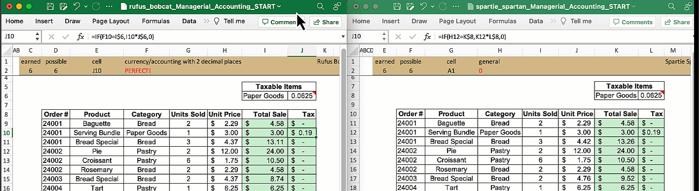
Low-Level Honesty Controls
Value Shifting
  Assigns unique values to each student's workbook
Formula Shifting
  Shifts cells random number of columns and rows to create unique cell references

Slide 13
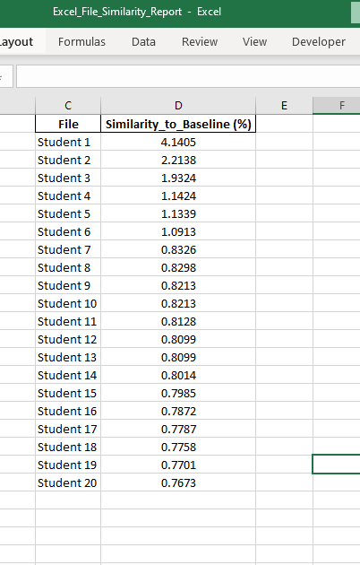
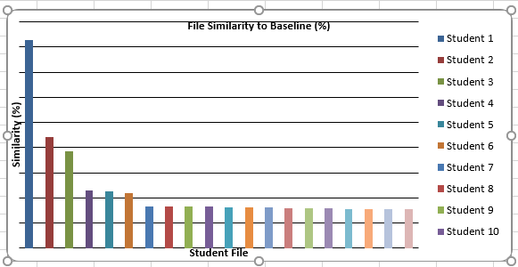
How much do files differ?
Uploaded 20 student assignments generated with Tab Pool Randomization into ChatGPT
  Politely requested a similarity report
    (making sure to stay on the terminator’s good side for the eventual reckoning)
Closest similarity = 4.14%
All <5%

Slide 14
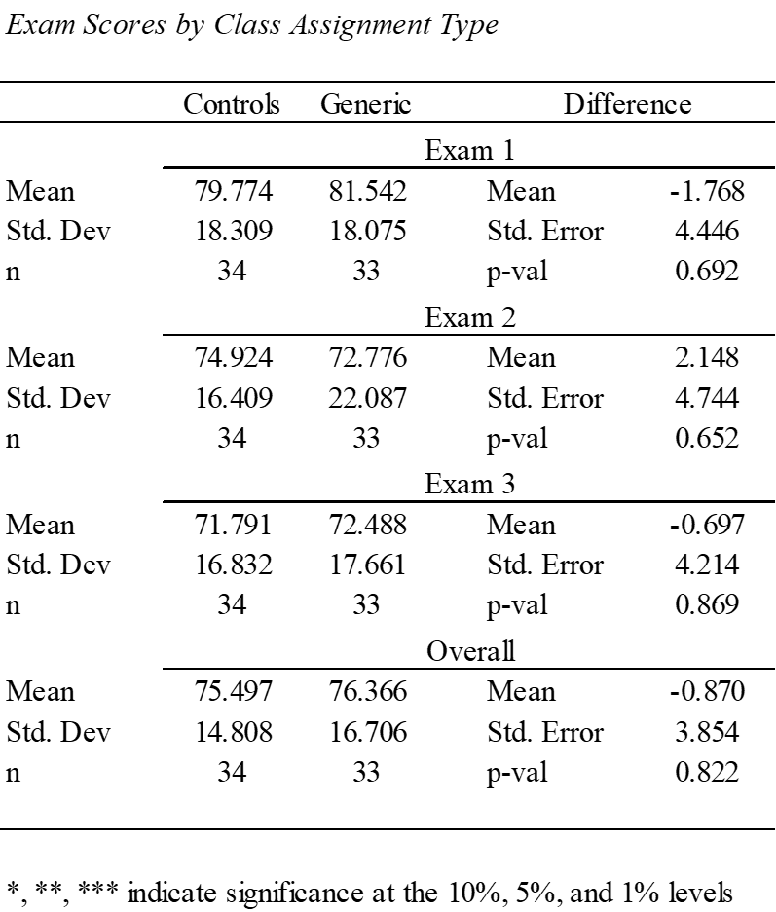
Does the Tab Pool Minimize Cheating? Improve Performance?
For small class sizes, no evidence.
Experiment:
Two sections of Business Statistics with identical layouts
  Same Instructor & Text
  35 Students per class
One class receives generic assignments (everyone has the same file)
  This is our Generic group
The other class receives academic integrity controls (Control group)
  Randomized tabs & values
  Shifted cells
Compare Exam Scores: Control versus Generic
  No significant difference for any of the three exams administered
Potential Explanation: Monitoring
  Small classes may not share files as much due to perceived awareness of the Professor

