Slide 1

Training Structured Inquiry:
Guided Notes, Socratic Dialogue, and Prompt-Based Reasoning in Business Analytics Education
Janna Chimeli
Raymond Frost
Ellen Gordon
Timothy Haase
Lauren Kenyo
Vic Matta
Adam Moyer

Slide 2
How many phone numbers do you know by heart?
Technology has been incredible at removing friction, but sometimes it also quietly removes skills we used to practice without realizing it.
And none of those skills were really about the numbers. They were about something deeper: paying attention, noticing patterns, and thinking through problems ourselves

Slide 3

Our students are on auto-pilot
Transferring knowledge from templates to real world reports or data
Results are treated as a final step rather than claims to be evaluated
Reasoning quality is often invisible to instructors

Slide 4


Slide 5
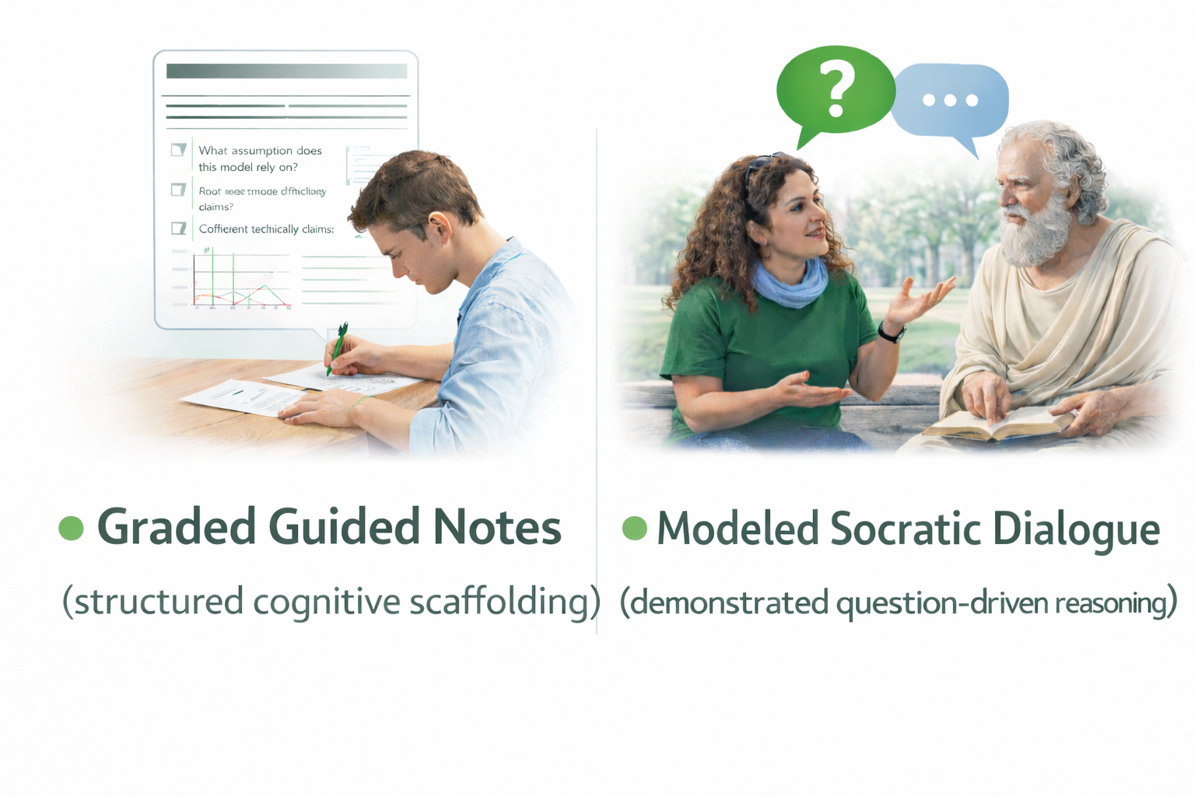

The Framework
Three integrated components:
Prompt-based reasoning (AI-transferable inquiry)

Slide 6

Component 1: Graded Guided Notes as Cognitive Scaffolding
Embed directly into assignments
Automatically graded
Reduces cognitive load

Slide 7
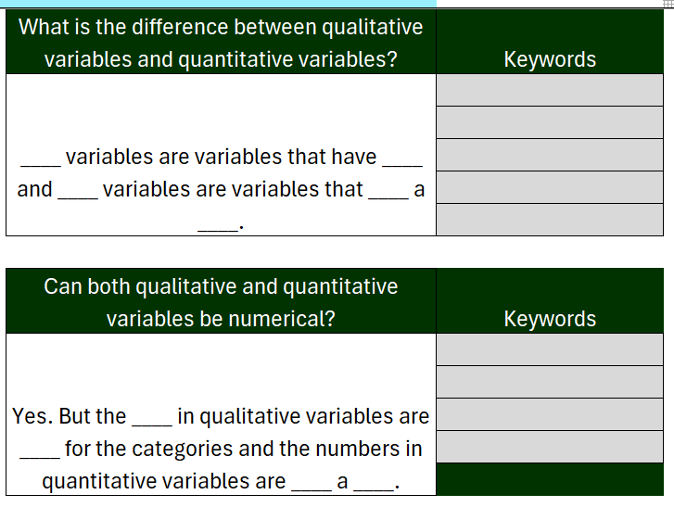
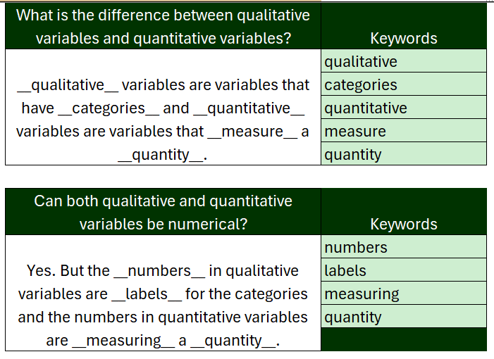
The Student Experience

Slide 8
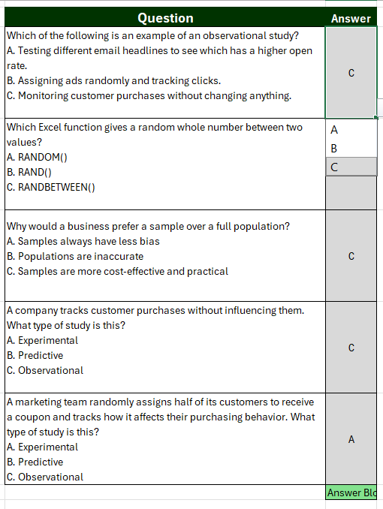

Slide 9
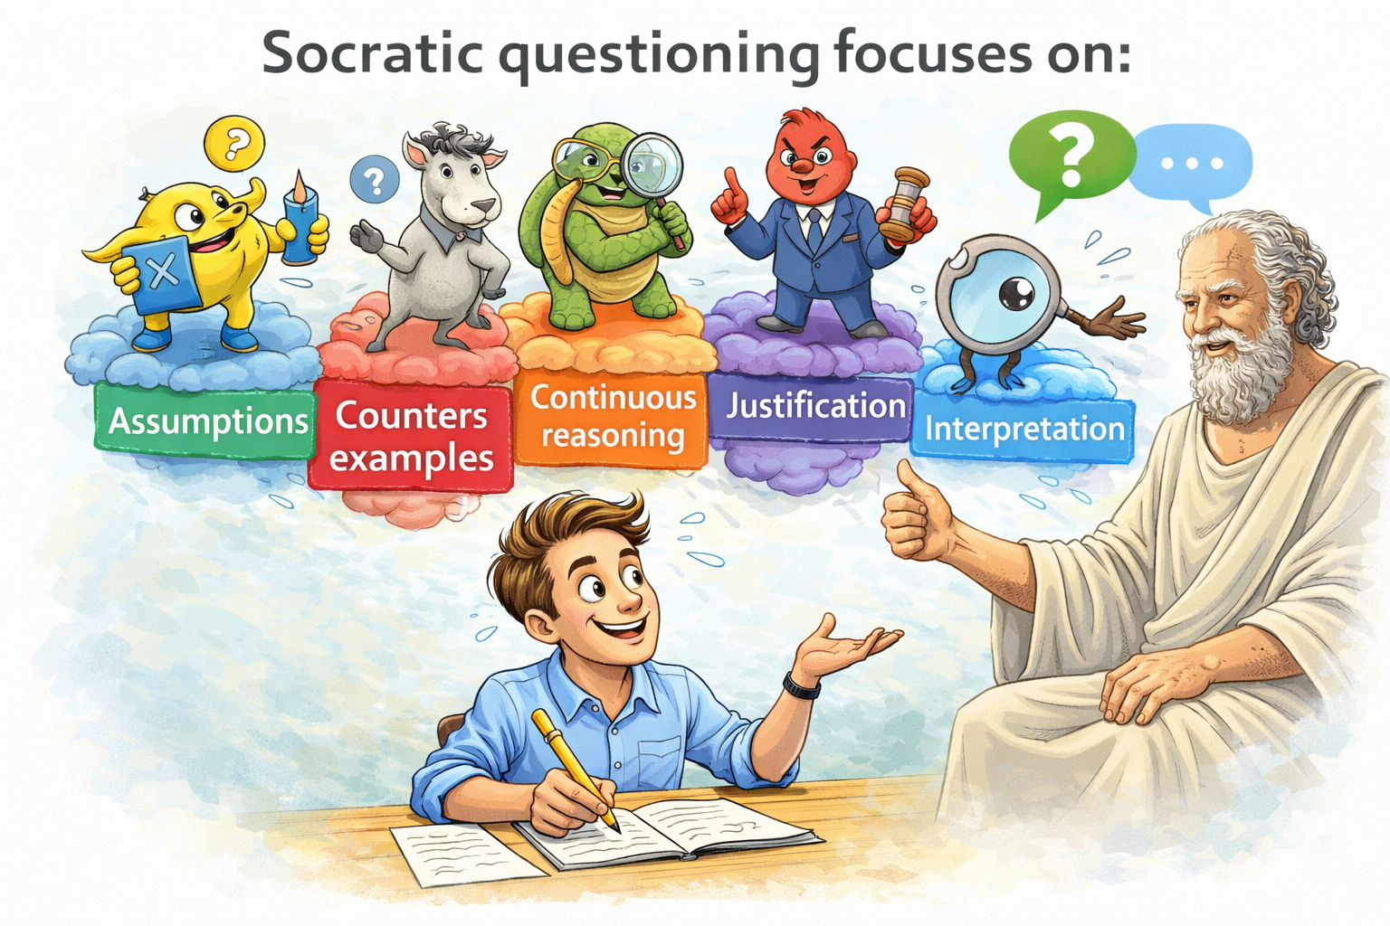
Component 2: Modeled Socratic Dialogue as a Learning Engine

Slide 10
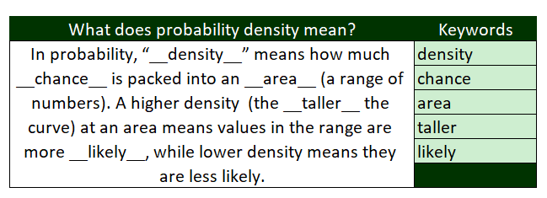
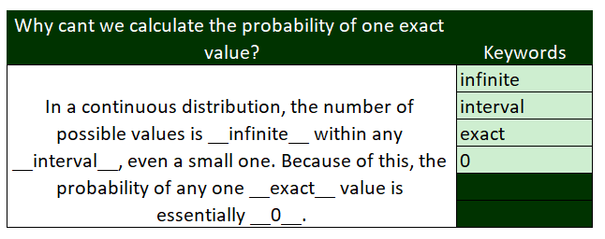
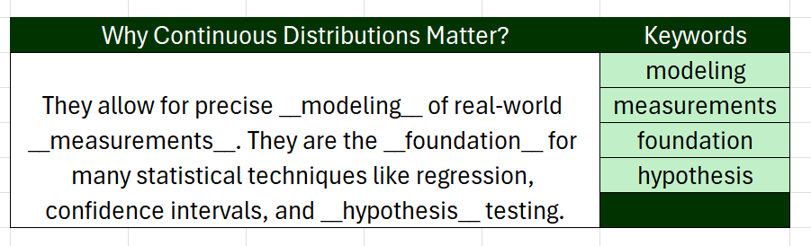
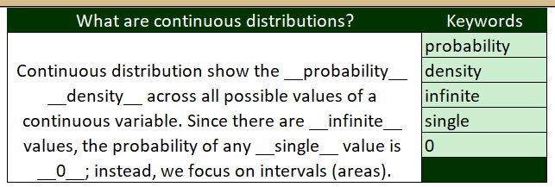
Structure Inquiry

Slide 11
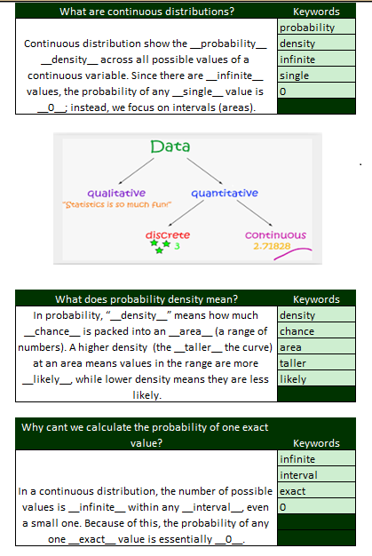
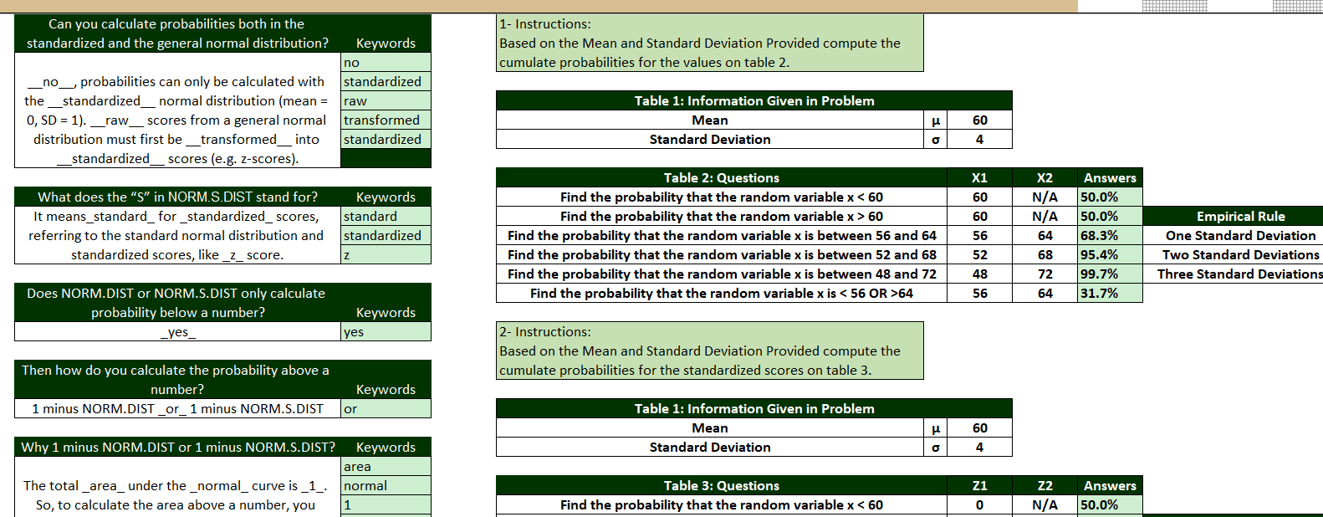

Slide 12
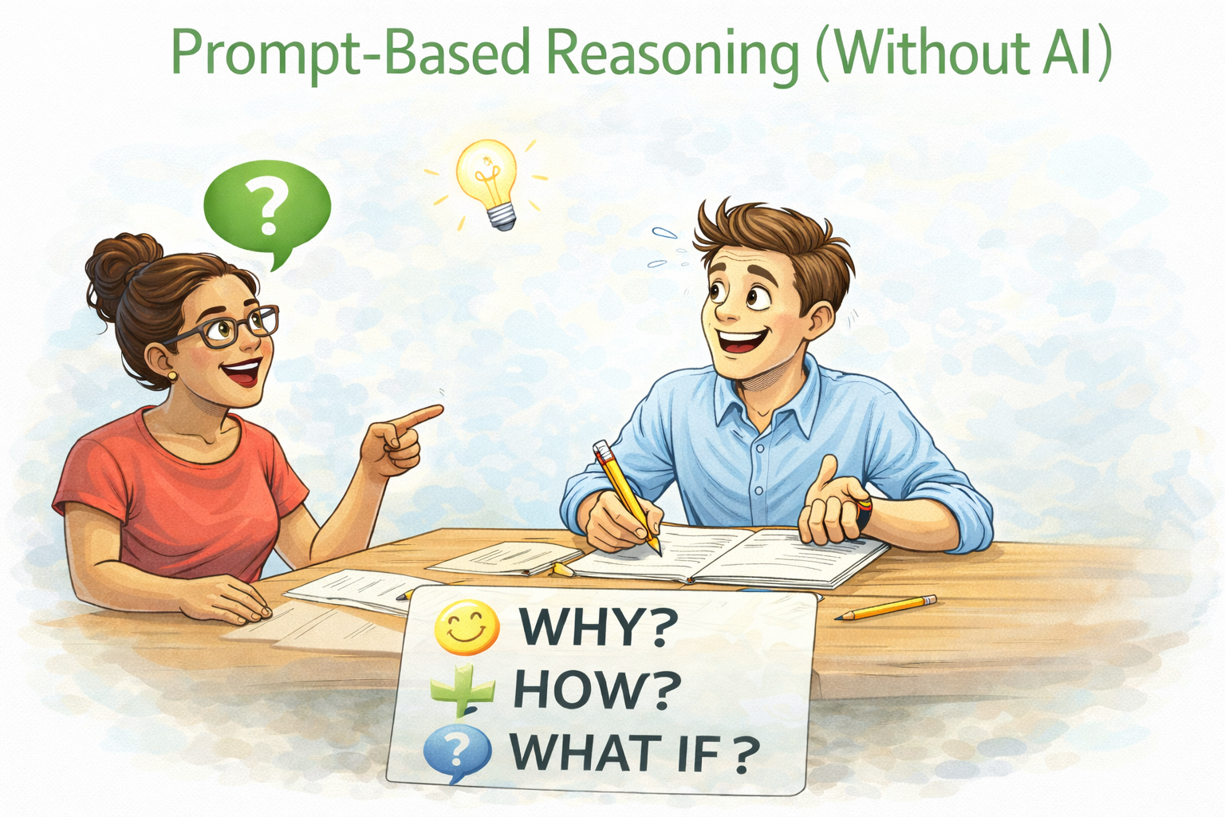
Component 3: Prompt-Based Reasoning (Without AI)
Prompts are primarily cognitive tools.
Students practice:
Specifying context
Braking information down
Requesting justification
Refining questions based on feedback

Slide 13
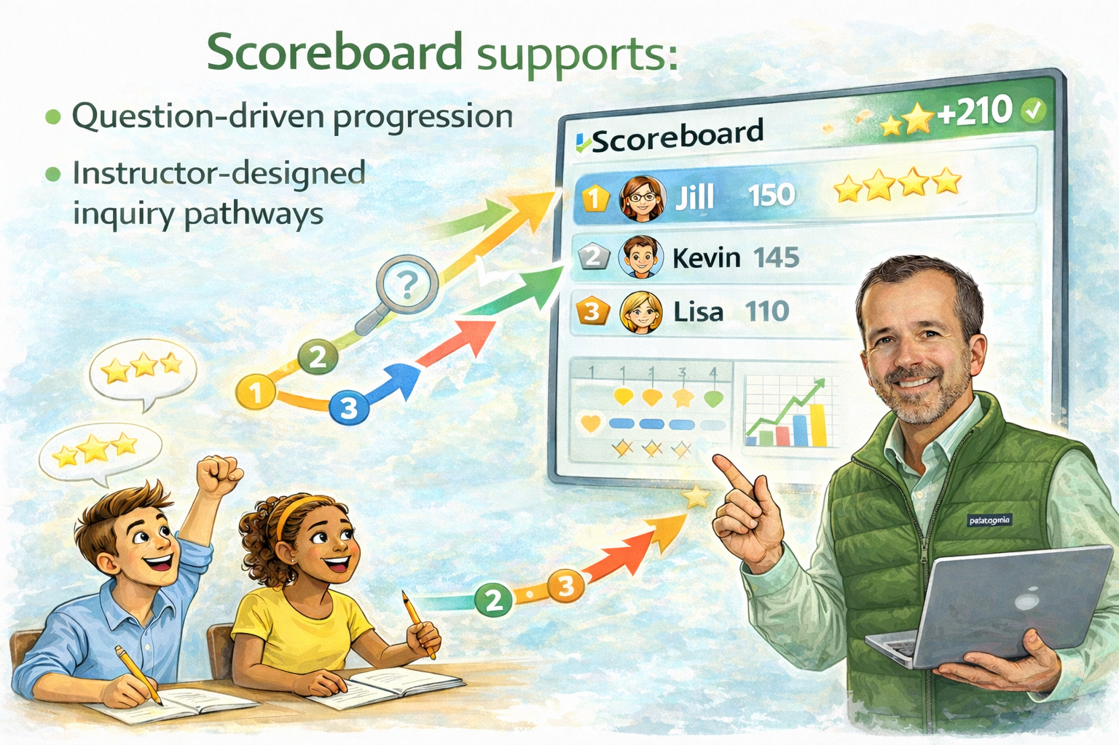
Why Scoreboard Enables This Framework

