Slide 1

Automated Assurance of Learning Assessment: Streamlining AACSB Compliance Through Technology-Enhanced Learning Outcome Tracking in Business Statistics
AoL
Lauren N. Kenyo
Timothy J. Haase
Janna Chimeli
Raymond D. Frost
Ellen R. Gordon
Vic Matta
Adam C. Moyer

Slide 2
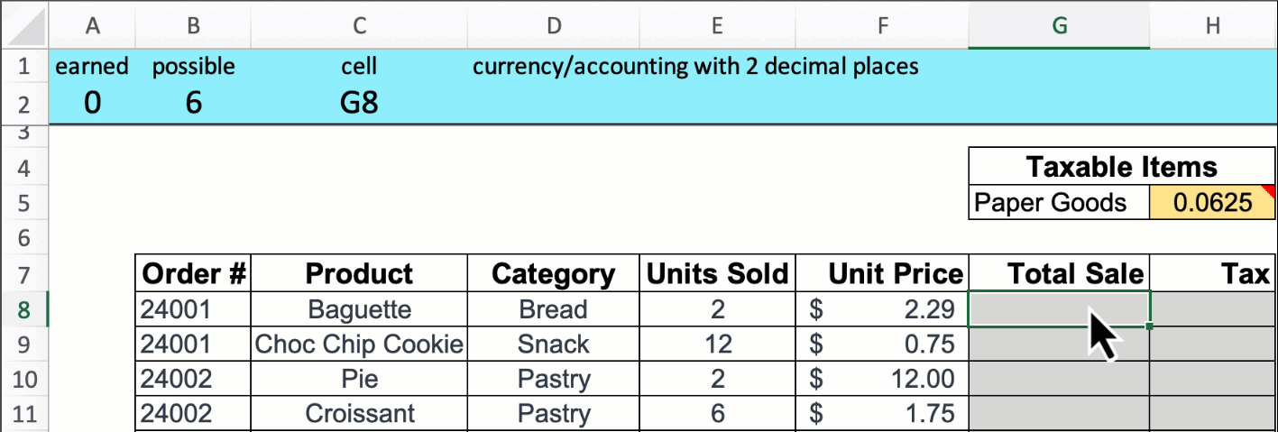
Scoreboard for Excel
Downloadable (AND FREE) EdTech software that works with Excel
  Office 365 or Excel 2021 versions – Mac or Windows
Make assignments, exams, in-class problems
Customized to your preferences
Provides feedback while users work through their files
Can create an entire class assignment/grade entire class in seconds
Can increase the difficulty
and add additional honesty
controls
Access the website:
www.scoreboardexcel.com

Slide 3
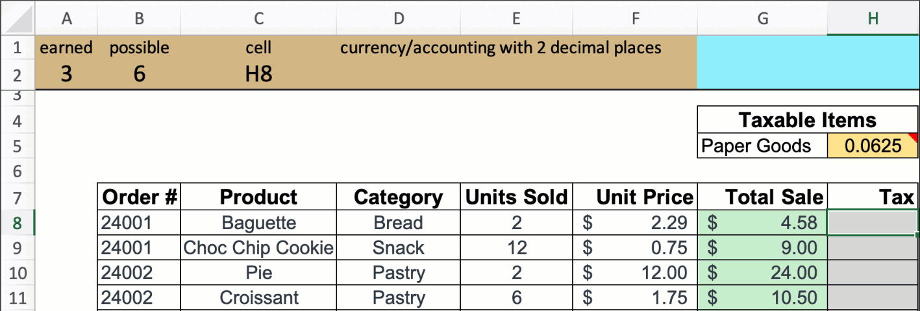
Scoreboard Features
Provides solution feedback in real time
Indicates correct and incorrect solutions with green and pink cell fill
Prompts users to fix:
  Incorrect answer values
  Manually typed values
  Missing cell references
  Missing absolute references
  Incorrect cell formatting

Slide 4
The Big Deal with Assurance of Learning
Three ways to do Assurance of Learning for AACSB:
Hand code every student, every criteria: 10 hours
M/C tests, code every question
  But M/C is not authentic or holistic
  Moreover, with AI, M/C tests are subject to cheating
Scoreboard: Code select questions in an authentic assessment
  Automatically grade and report summative AoL scores
  for each criterion for each student

Slide 5
Scoreboard Automates AOL Reporting
  Faculty
    Enter all learning outcomes
    Assign learning outcomes
  Scoreboard automatically calculates
    Each student’s score for each component
    Aggregates into a report
    In less than 5 minutes!
  All faculty report positive experiences

Slide 6
AOL Criteria
Rating Criterion | Performance Dimension | For Example
Representation | The ability to convert relevant information into various mathematical forms (e.g., equations, graphs, diagrams, tables, words) | Select case and identify relevant statistics (9 questions)
Calculation | The ability to calculate relevant information using various mathematical formulas | Computing test statistic (8 questions)
Assumptions | The ability to make and evaluate important assumptions in estimation, modeling, and data analysis | Choosing the appropriate test (5 questions)
Interpretation | The ability to explain information presented in mathematical forms (e.g., equations, graphs, diagrams, tables, words) | Interpret confidence interval for t test / interpret regression (5 questions)
Application / Analysis | The ability to make judgments and draw appropriate conclusions based on the quantitative analysis of data, while recognizing the limits of this analysis | Accept/Reject and Why (6 questions)
Communication | The ability to express quantitative evidence in support of the argument or purpose of the work (in terms of what evidence is used and how it is formatted, presented, and contextualized) | Reflect and communicate results (5 questions)
Notes:
-So now I am going to walk you through a mini demonstration on how we code or set up an assignment to be rated for AoL.
On this slide I am going to go over our AoL criteria. These criteria and their definitions have been provided by our institution; however, these dimensions differ from institution to institution.
You can use whatever dimensions you prefer. People can use for AoL or for other exams in which you are interested in creating subscores for an assessment.
-What we did what identified two problems sets (one sample t-test and regression) . We then mapped out questions to each dimension.
-For our demonstration, we are going to focus on two dimensions: representation and assumptions.
Representation is the ability to convert relevant information into various mathematical forms. And the mapped question we are going to use is the null and alternative hypothesis in symbols.
Assumptions is the ability to make and evaluate important assumptions. The mapped question is to choose the appropriate test – so students read a research description and have to idenfity the appropriate statistical test and the direction of the test (left, right, two-tailed).

Slide 7
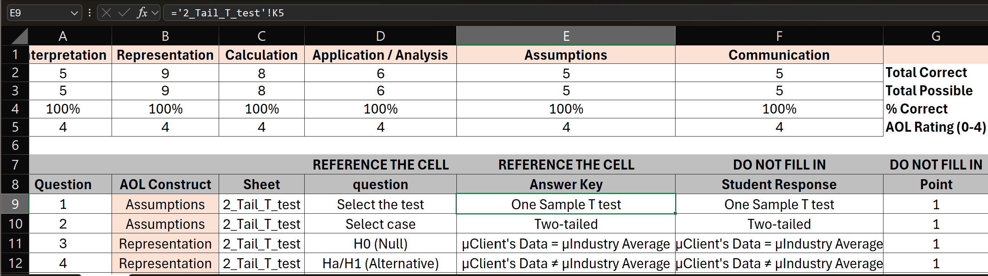
Coding for AoL
Notes:
So here is the coding rubric that we use. Again, this is a tab in Excel that you would include in the assessment – that it is part of the assessment. Students will not see this tab as it will be hidden in their assignment.
The instructor only has to fill in 4 cells for each items.
First, you have to indicated the construct or dimension – again, you can choose any dimension you prefer. There is a running tally for each dimension on top. We recommend having a minimum of 4 items per dimension.
You then have to type in the sheet name.
Next you reference the question – again it must be in the same workbook.
Then the students responses and their scores points will fill in. Again, this tab is hidden in the students version of the assessment. .

Slide 8
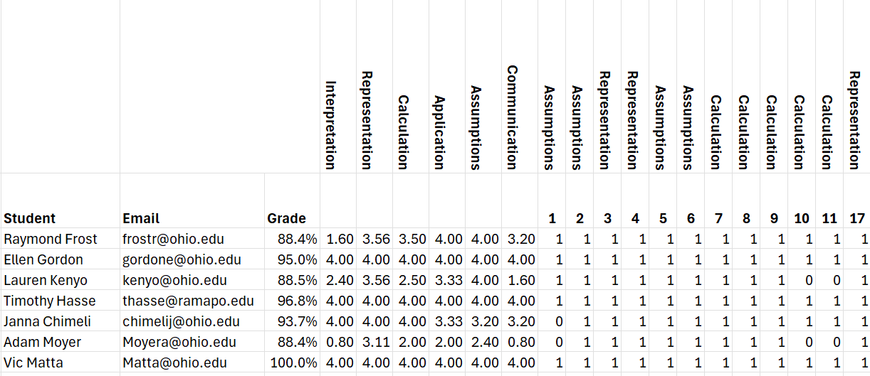
Scoreboard’s AoL Report
Aggregate info
Detail scores
Demographic info
Notes:
The instructor then runs the files through the grading program and receives a grading report.
So the first report is the report provided by scoreboard – this allows you to import your grades into your LMS.
The report also provides a detailed layout.
Students receive an average score for each dimension – scaled 0-4. These are the scores that we submit to our institution for AoL.
You will also get a detailed score that is broken down by item – this is great if there is an error in the key. You can easily removed an item from the average score. We also have used it to compute statistics on items
For example, you can compute Cronbach alpha to determine the reliability of each subscale or dimension.
There are also discrimination analyses – this help instructors identify questions that are good at separating the A students from the failing students.

Slide 9
Scoreboard does AoL: Benefits
  Efficiency: AoL scores are calculated and aggregated < 5m
  Granular multi-dimensional assessment
  Collect → Analyze → Report
  Fully automated
  Innovative, flexible and free
  Reports on each dimension for each student
  Perfect inter-rater reliability b/c objective
  Easily fix coding errors after the fact
Access the website: www.scoreboardexcel.com

