Slide 1

Feedback Thresholds and Learning Independence: A Comparative Study of Scaffolded Technology Integration in Business Statistics Education
Ellen Gordon, Ohio Univ
Timothy Haase, Ramapo College
Janna Chimeli, Ohio Univ
Raymond Frost, Ohio Univ
Lauren Kenyo, Ohio Univ
Vic Matta, Ohio Univ
Adam Moyer, Ohio Univ

Slide 2
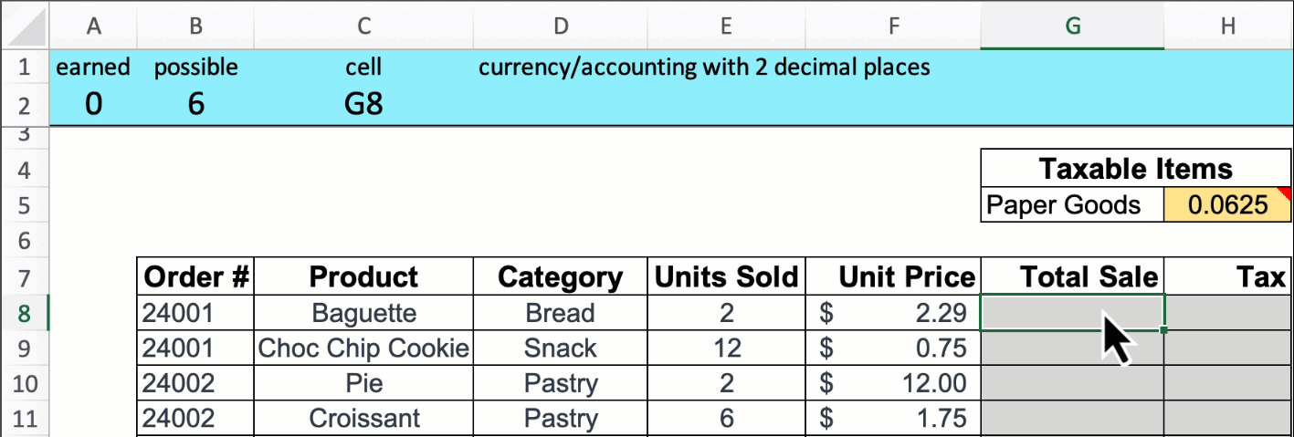
Scoreboard for Excel
Students who received immediate feedback:
  Had higher levels of intrinsic motivation
  Were more likely to fix incorrect attempts
  Received higher grades on assignments
  Felt they knew the material better and were less stressed
  Did not spend more time on the assignment
  Sasmaz, Frost, Gordon, Kenyo, Matta & Raisch (2025)

Slide 3
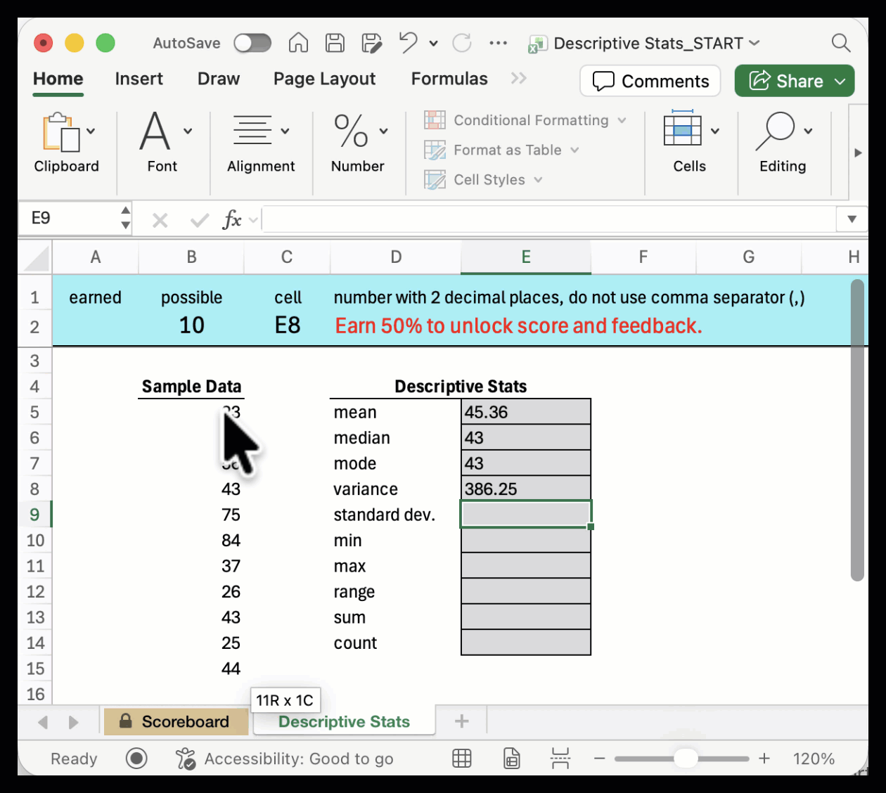
Thresholds – feedback withheld until 50% correct

Slide 4
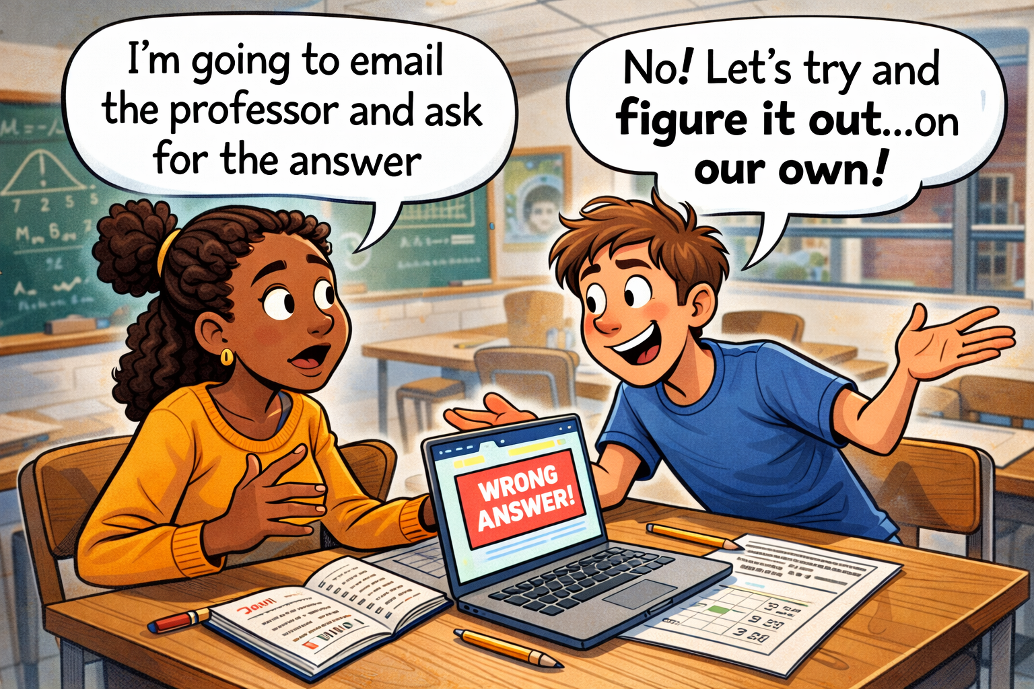
Hypotheses
Threshold systems encourage students to think more deeply or critically about the problem.
Threshold systems encourage students to check their answers.
Threshold systems result in better performance on assessments.
Students perceive the threshold system as fair.

Slide 5


Method
Ohio University
11 sections of Introductory Business Analytics (online & in-person)
  ~70 students per class / 5 instructors
  5 classes were randomly assigned to use 50% thresholds on homework assignments (Threshold condition)
  6 classes were randomly assigned to complete assignments with immediate feedback (No Threshold condition)
All classes completed a survey at the end of the HW assignment.
  Competency quiz and self-report questions (“I checked my work”, “I thought deeply”, etc.)
Experiment was conducted for two modules (IF functions & Index Match)
Ramapo College
Two sections of Business Statistics (hybrid)
  35 students per class
  Same Instructor and course design
One class had thresholds on in-class work and homework assignments
  100% on in-class assignments
  60-70% on homework
The other class received immediate feedback
Survey completed at semester end
Experiment was conducted the entire semester because I (Tim) am a monster

Slide 6
Findings
Ohio University
1. No differences on HW / Exam averages
2. Drastically increased the # of perfect scores
3. No differences on the competency quiz
4. No difference on self-report questions
Exception: The threshold group found the grading system more frustrating and less fair after module 2. After module 3, there was no difference in fairness, and the effect for frustration had weakened.
Ramapo College
Exam Scores: Control versus Threshold
  No significant difference for any of the exams administered within the Fall 2025 semester
Survey Data: control for other factors
  Did the student take a basic stats prereq? [No difference]
  Were they familiar with Excel already? [No difference]
    Did they take a basic stats prereq & were familiar with Excel aready [No difference]
There are correlates between perceived learning in the threshold class

Slide 7
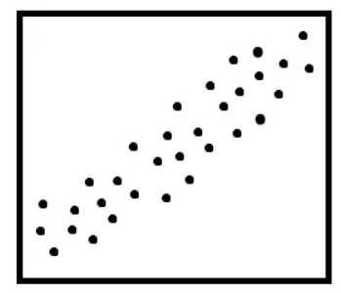
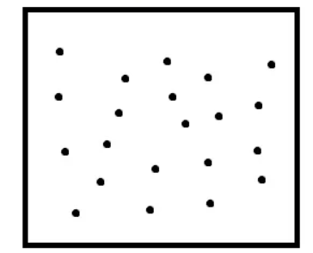
Expected Correlation: Perceived Understanding & Exam Grades
Exam Scores
Exam Scores
Perceived Understanding
Perceived Understanding

Slide 8
Survey Correlations: Likert Q’s
To what extent did the Excel assignments contribute to your sense of support in the following areas?
How often did the Excel assignments encourage or support you to do the following?
To what extent do you agree with the following statements?
All on a scale of 1 – 5
  (Not at All) – (Very Much)

Slide 9
Perceived Competence & Exam Performance
 | (1)
Variables | ExamAvg
Threshold | 0.640
 | (2.950)
Understanding_Centered | -0.364
 | (2.477)
Threshold x Understanding_Centered | 9.544***
 | (3.250)
Intercept | 77.403***
 | (2.253)
Observations | 62
R-squared | 0.226
Adj. R-squared | 0.186
F-statistic | 6.92
RMSE | 11.595

Slide 10
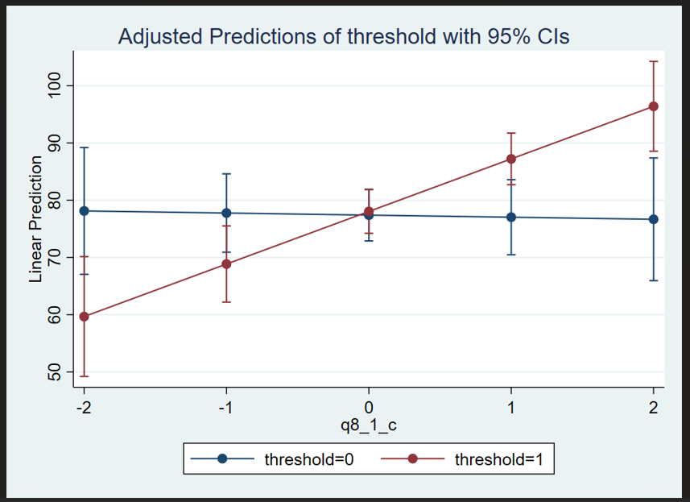
Predicted Exam Grade
.
Understand Course Material

Slide 11
Perceived Competence & Exam Scores
 | (1) | (1)
Variables | ExamAvg | ExamAvg
Threshold | 0.640 | 1.221
 | (2.950) | (2.860)
Understanding_Centered | -0.364 | -0.805
 | (2.477) | (2.276)
Threshold x Understanding_Centered | 9.544*** | 7.773**
 | (3.250) | (3.052)
GPA |  | 8.527**
 |  | (3.519)
Intercept | 77.403*** | 47.798***
 | (2.253) | (11.796)
Observations | 62 | 61
R-squared | 0.226 | 0.276
Adj. R-squared | 0.186 | 0.224
F-statistic | 6.92 | 7.34
RMSE | 11.595 | 11.24
_Centered implies deviation from the mean
A 3.0 GPA student with average perceived understanding (3.855)
  ~73.379 exam average
Students who worked through threshold assignments and have an increased perception of understanding
  +7.773 to exam average per point above the average
An “On-the-ball” student with perceived understanding of 5 and 4.0 GPA
  ~90.8 exam average
Notes:
We conducted another multiple regression analysis and included GPA. Students GPA is most likely influencing their perceived competence – if you have a high GPA, you might be more likely to think you have a good grasp of academic material. Thus, we added GPA in order to remove the effects of previous performance.
As expected, student’s GPA significantly predicted their exam scores. However, our interaction term was still significant despite GPA being part of the model. This suggest that the thresholds still impacted the accuracy students perceived competence, despite their previous academic performance.
All of this together suggests that delayed feedback or thresholds fosters understanding of one’s skill and competencies.

Slide 12
Conclusions: Thresholds & Metacognition
Metacognition: “Thinking about thinking”
Metacognition in higher education: “Thinking about learning”
  Assessing knowledge, utilizing proper learning strategies, etc.
  Improving metacognition is crucial to improving performance
Understanding what one understands and what one hasn’t grasped is a fundamental skill of metacognition
Hypothesis: Delayed feedback improves metacognition, specifically the ability to assess one’s own understanding of the material.

Slide 13
Hypothesis: Feedback thresholds increase the likelihood that students will accurately assess their mastery of course topics.

Slide 14
Future Research
Future research should explore the relationship between thresholds / delayed feedback and metacognition.
Exam Wrappers – ask students before and after to estimate their exam grade (Zabrucky & Bay, 2011)
This allows students to see how accurate they are and to calibrate their perceptions
Research suggests that exam wrappers improve metacognition
Hypothesis: Students who use thresholds are better calibrated in comparison to students who receive immediate feedback and hopefully, over time this will improve long term retention.
  We would predict that this would occur for any computer-based training program (McGraw Hill Connect, Pearson’s MyLab)

Slide 15

We appreciate any comments, questions, or feedback
Sincerely,
The Ohio Gang and Tim
Questions? Comments?
Ellen Gordon
Gordon@ohio.edu
Timothy Hausse
Notes:
Thank you so much for attending our talk. I can now accept any questions or comments.

Slide 16
Appendices

Slide 17
Perceived Competence & Exam Scores
 | (1) | (1)
Variables | ExamAvg | ExamAvg
Threshold | 0.640 | 1.221
 | (2.950) | (2.860)
Understanding_Centered | -0.364 | -0.805
 | (2.477) | (2.276)
Threshold x Understanding_Centered | 9.544*** | 7.773**
 | (3.250) | (3.052)
GPA |  | 8.527**
 |  | (3.519)
Intercept | 77.403*** | 47.798***
 | (2.253) | (11.796)
Observations | 62 | 61
R-squared | 0.226 | 0.276
Adj. R-squared | 0.186 | 0.224
F-statistic | 6.92 | 7.34
RMSE | 11.595 | 11.24

Slide 18
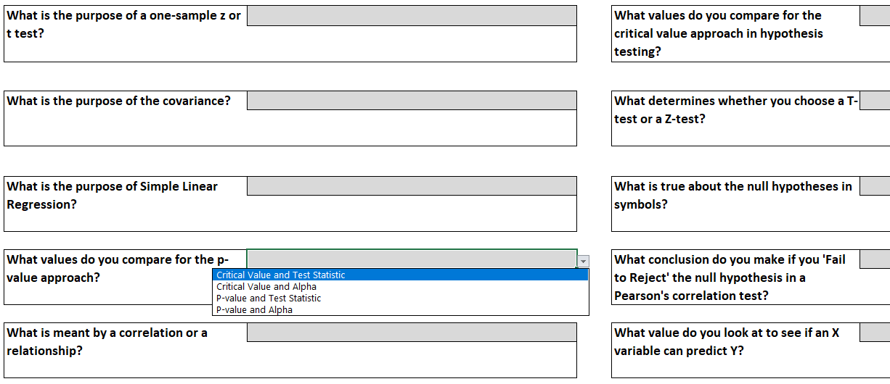
Conceptual Questions

Slide 19
Conceptual Question Performance
Score group | No Thresholds | Thresholds
90–100 | 28.13% | 35.29%
80–<90 | 12.50% | 5.88%
70–<80 | 3.13% | 5.88%
60–<70 | 12.50% | 14.71%
<60 | 43.75% | 38.24%
Statistic | No Thresholds | Thresholds
N | 32 | 34
Mean | 0.654 | 0.693
Median | 0.625 | 0.688
Std Dev | 0.293 | 0.279
Skewness | -0.473 | -0.697
Min | 0 | 0
Max | 1 | 1

Slide 20
Survey Correlations: Likert Q’s and Exam Average
Question | Rho (No Threshold) | Rho (Threshold) | Fisher r-to-z | p (one tail)
Understand course material | 0.101 | 0.642 | 2.509 | 0.006
Confidence in your learning ability | 0.139 | 0.488 | 1.495 | 0.067
Improve critical thinking skills | 0.114 | 0.447 | 1.393 | 0.082
Reducing academic stress or anxiety | 0.005 | 0.372 | 1.463 | 0.072
Using Excel helped me complete tasks more quickly | -0.040 | 0.380 | 1.672 | 0.047
Ask questions or seek help when needed | -0.584 | 0.276 | 3.618 | 0.000
Collaborate with classmates | -0.118 | 0.236 | 1.364 | 0.086
The threshold class produced higher Likert-Exam correlations for all questions
Questions listed above are significantly higher following Fisher’s r-to-z test.

