Slide 1
Enhancing Analytics Education through Artificial Intelligence and Automated Learning tools
Raymond Frost, Janna Chimeli, Ellen Gordon, Vic Matta, Adam Moyer
Ohio University
Timothy Haase
Ramapo College of New Jersey

Slide 2
The problem – lack of intuitive understanding
Even after two analytics courses, our students do not have an intuitive understanding of statistical concepts such as standard deviation
They can “paint by numbers” following an “8 step” recipe for hypothesis testing—but they don’t really understand the concepts
Why are the concepts so difficult to internalize?
Confusing terminology
Counterintuitive reasoning—e.g., reject the null, hypothesized mean
Fragmented and non-visual presentation of concepts

Slide 3
The solution
Leverage intuition – bigger, smaller, within bounds, out of bounds
Visual marriage of concepts—multiple data series and axes
Animation—layered presentation of ideas
Real time feedback and grading
Excel

Slide 4
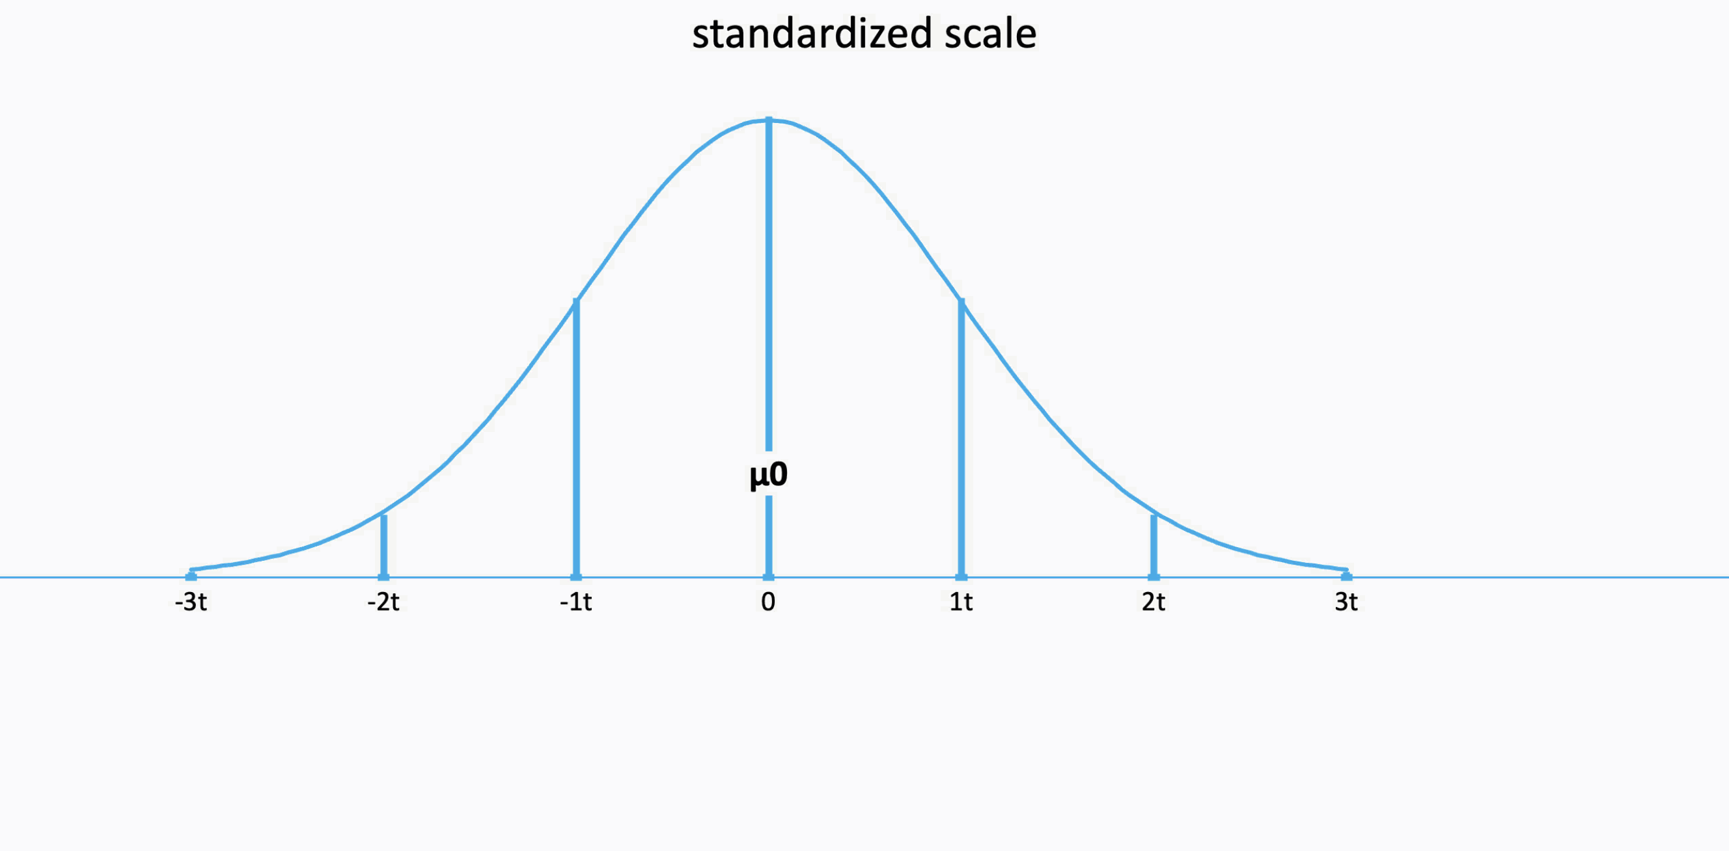
Hypothesis test: 6 axes, 22 data series, 100s of data points, 10 equations

Slide 5
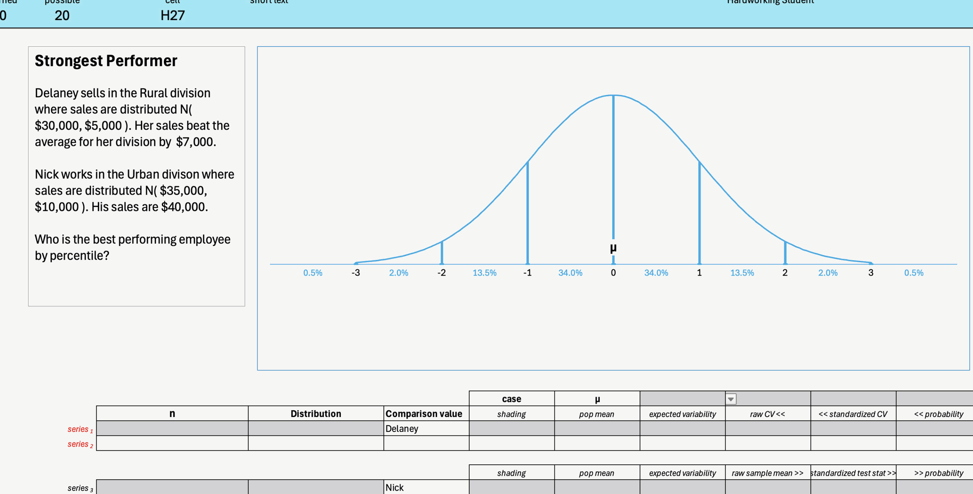
Probability of a single value: self-grading using ScoreboardExcel.com
Cells light pink for wrong answer, green for right answer. Total points earned and progress bar on scoreboard at the top.

Slide 6
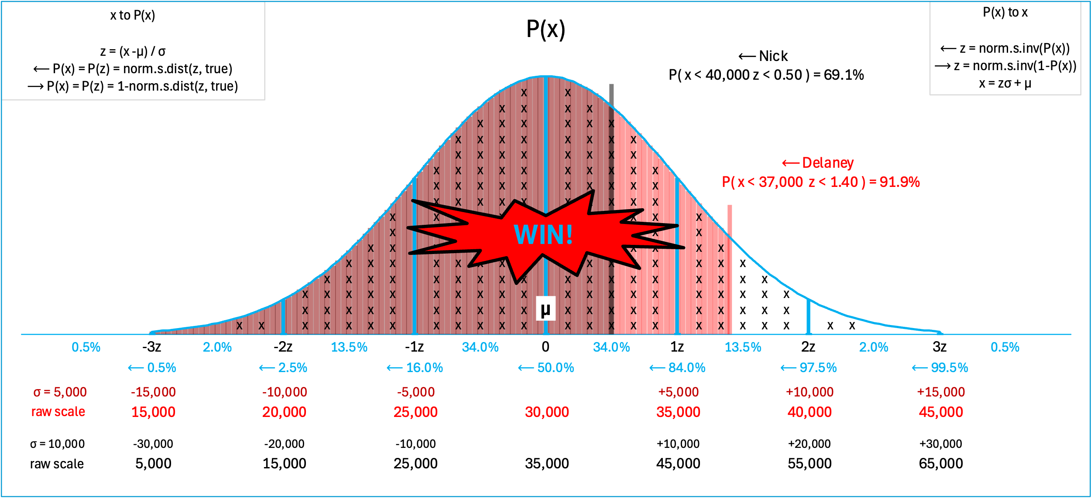
Probability of a single value concepts from the chart:
z scores
empirical rule
percentiles for each
two different raw scales
two different standard deviations
Conclusion
Solution algorithm
This means that you could introduce probability intuitively purely from pictures before getting to a single calculation. It also means that students could themselves derive decision rules such as to compare performance based on z scores and percentiles rather than raw values.

Slide 7
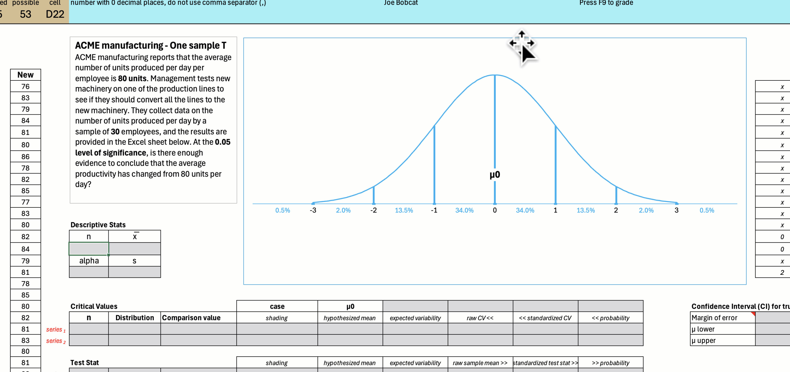
Hypothesis test: One sample T self-grading using ScoreboardExcel.com
Cells light pink for wrong answer, green for right answer. Total points earned and progress bar on scoreboard at the top.

Slide 8
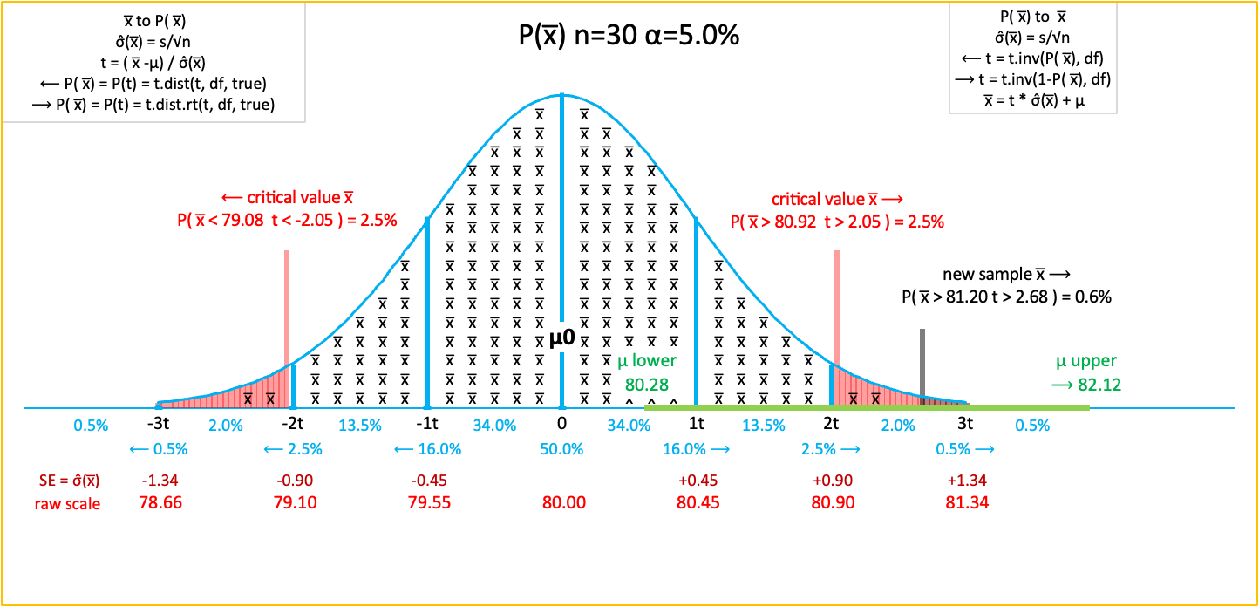
Hypothesis test: One sample T concepts from the chart:
H0
Ha
Type of test
n, alpha
Sample mean
Observed difference
Standard Error (SE)
Test statistic
Critical value(s)
p-value
Conclusion
Implication
Confidence Interval
Empirical rule
Solution algorithm
This means that you could introduce hypothesis testing intuitively purely from pictures before getting to a single calculation. It also means that students could themselves derive decision rules such as to reject H0 if the sample x̅ is more extreme than critical values.

Slide 9
Use ChatGPT to generate new problems. Here is the prompt:
Please write 1 sample T test problems similar to these with the following constraints:
The context should be business related but interesting
1 one-tail left significant
1 one-tail left not significant
1 one-tail right significant
1 one-tail right not significant
1 two tail significant
1 two tail not significant
Also produce the data sets for each in an Excel file. Each dataset should be between 30 and 50 records in a single column. Place each problem and its dataset on a separate tab of the Excel file. The problems should appear in text boxes on each worksheet.

Slide 10
ChatGPT output
A company claims that employees work an average of 100 hours per month. Management believes the work hours are lower than this and collects a sample to test their hypothesis at a 0.05 significance level.
An online retailer reports that the average purchase amount per transaction is $200. They suspect that recent promotions have not significantly lowered the average purchase amount. A sample of transactions was collected to test at the 0.05 level.
A factory's old machines produce an average of 300 units per day. Management tests a new machine to determine if output has increased. A sample was taken, and at a 0.05 significance level, they test whether production has increased.
A website typically loads in 400ms on average. A new optimization technique was applied to improve load times. A sample of load times was taken to see if the new method significantly reduces load time at a 0.05 level.

Slide 11
Scorechart and Scoreboard are free at www.ScoreboardExcel.com

Slide 12
Zero Day Stats – Guided Discovery Learning
Discovery learning is an approach to education where learners actively explore and discover information for themselves rather than being directly taught by an instructor. It is based on the idea that students learn best when they construct their own knowledge through experiences, problem-solving, and experimentation. In guided discovery learning instructors provide hints or scaffolding to help students discover concepts.
We think that the next series of slides, constructed using the template, could appear as a challenge on the very first day of class.

Slide 13
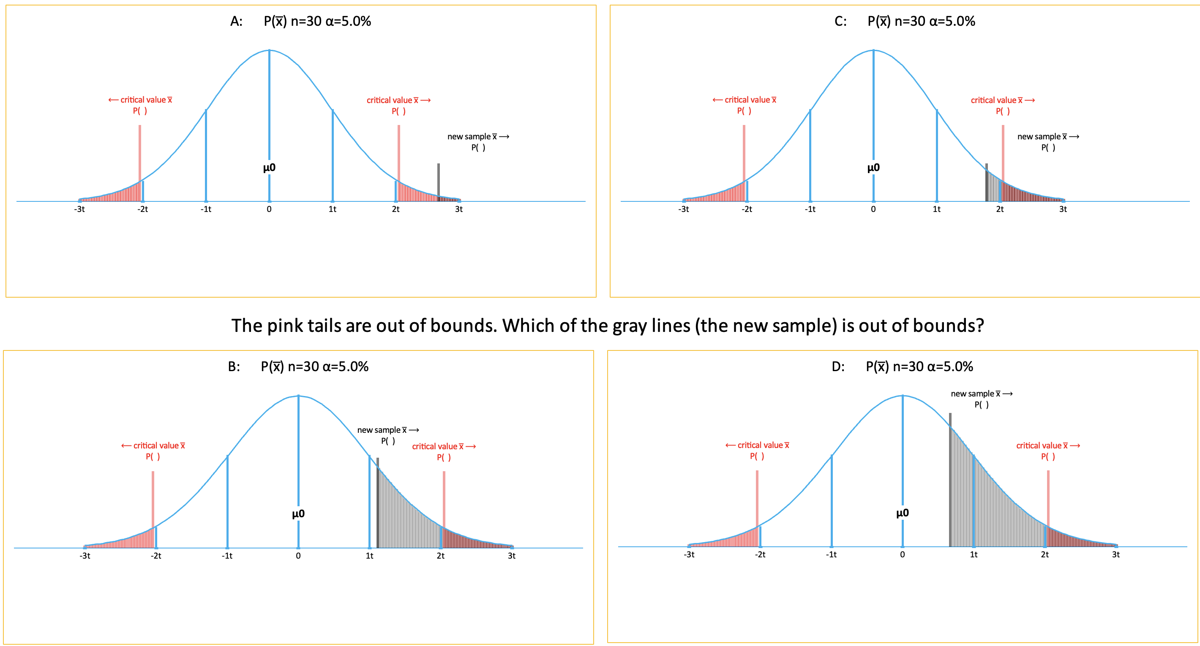
Zero day stats – out of bounds

Slide 14
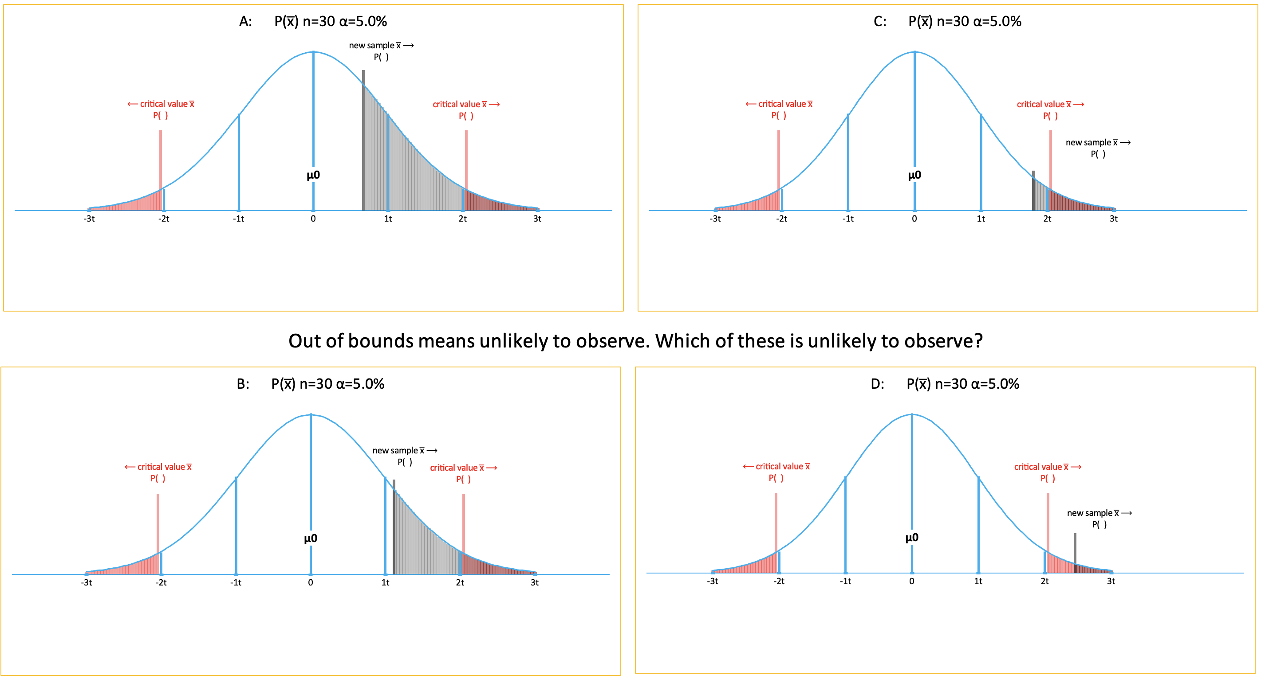
Zero day stats – unlikely to observe

Slide 15
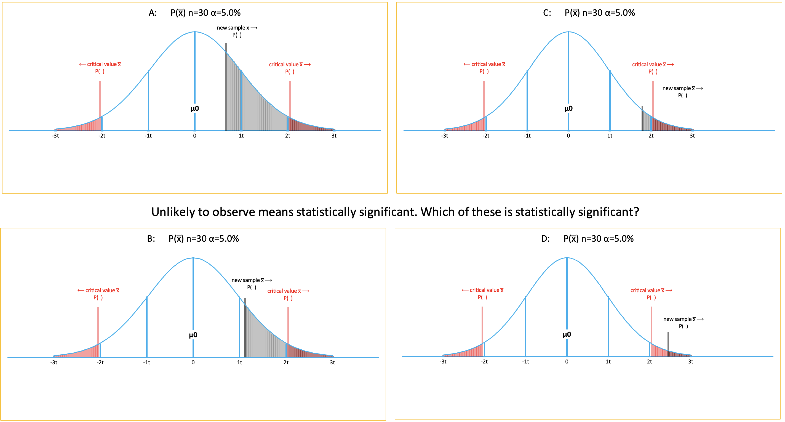
Zero day stats – statistical significance

Slide 16
Zero day stats – alpha and critical values
Notes:
t scores, table, alpha

Slide 17
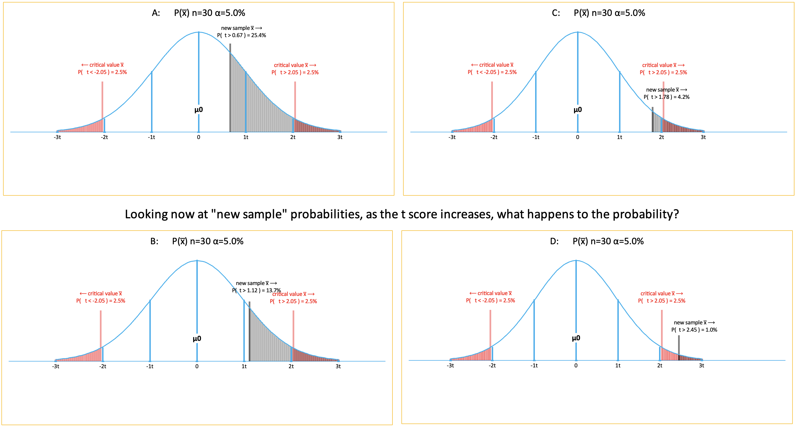
Zero day stats – relationship between t score and probability
Notes:
table

Slide 18
Zero day stats – central limit theorem

Slide 19
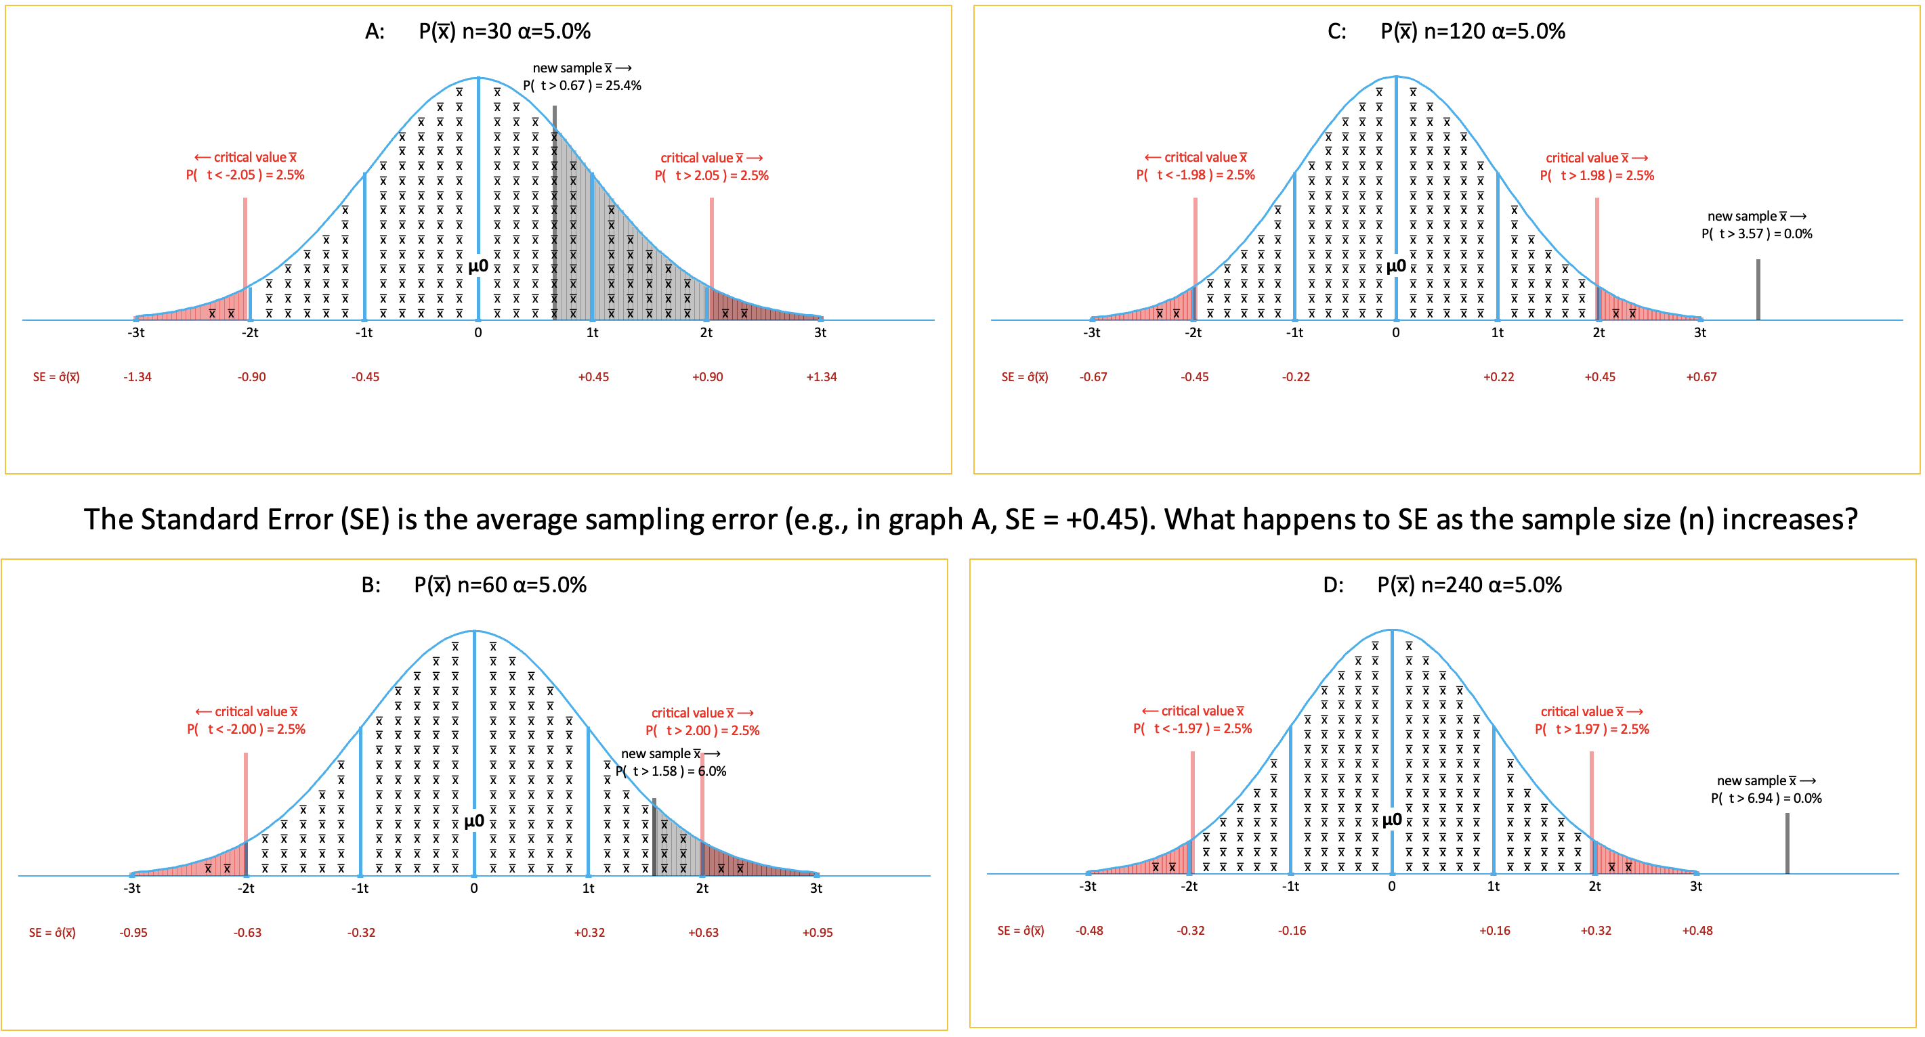
Zero day stats – law of big numbers

Slide 21
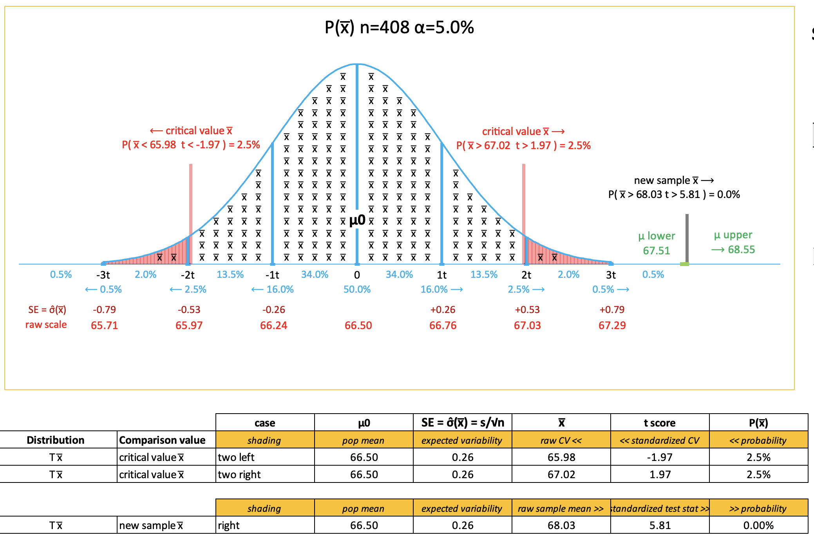
Assignment: Visualize SPSS Output

